Slide 1

San Juan County 2036 Comprehensive Plan Update
San Juan Visitor Bureau
November 1, 2017

Slide 2
Update Purpose
To review and update the Comprehensive Plan and development regulations to:
Accommodate the growth expected in the next 20 years,
Ensure compliance with GMA amendments, and
Reflect local needs, new data, and current laws.

Slide 3
Mandatory
Review & Update if Needed
GMA requirements;
Urban Growth Areas;
Critical area regulations; and
Mineral resource land designations and development regulations
Land use element;
Housing,
Capital facility, natural resource, utility, transportation, and other elements, and
Plan consistency

Slide 4
What is the Comprehensive Plan?
A blueprint or framework to guide decisions about future projects, programs and development in the County.
20 year horizon – looking ahead to the year 2036.
Vision
Goals to achieve the Vision “What?”
Policies about how to achieve the goals “How?”
Maps that guide the location of future development in terms of land use, density, transportation, capital facilities and parks “Where?”
Data and analysis that informs the community and elected decision-makers about the community’s challenges and opportunities “Why?”

Slide 5
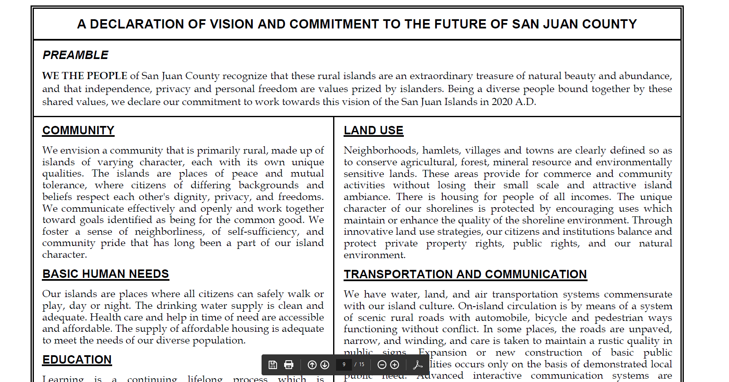
Vision
We the people of San Juan County recognize that these rural islands are an extraordinary treasure of natural beauty and abundance, and that independence, privacy and personal freedom are values prized by islanders…

Slide 6
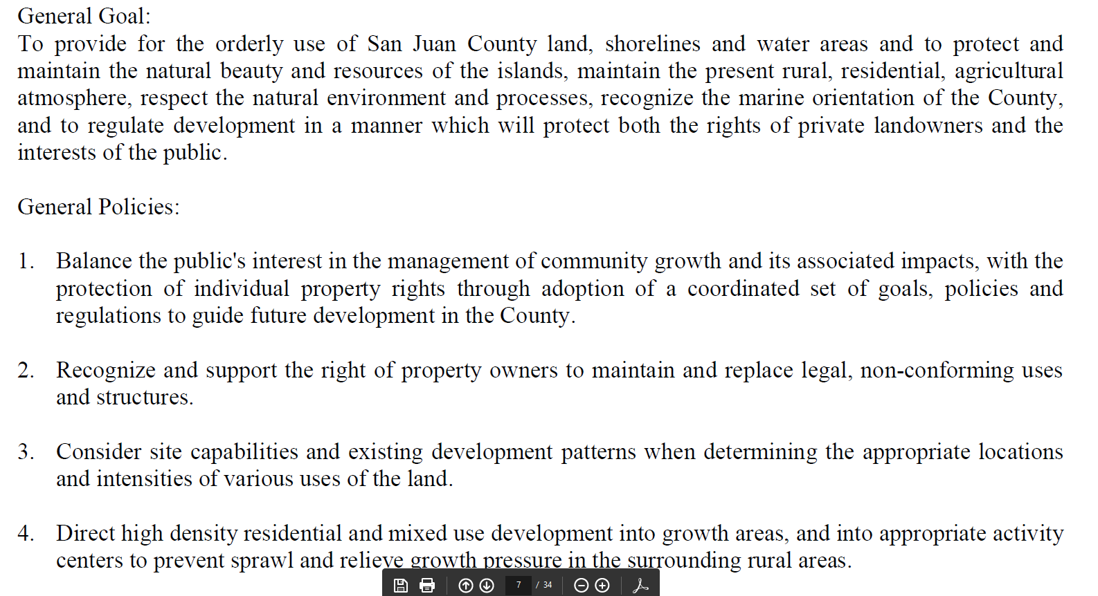
Goals and Policies

Slide 7
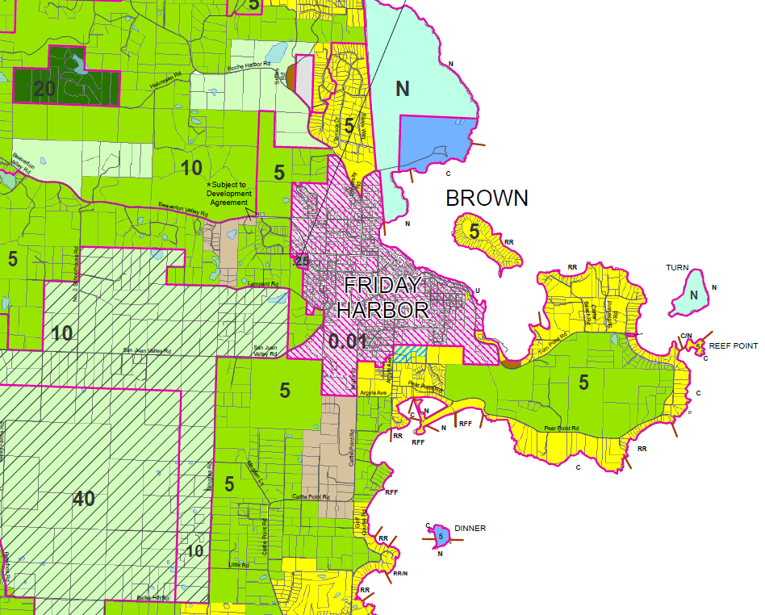
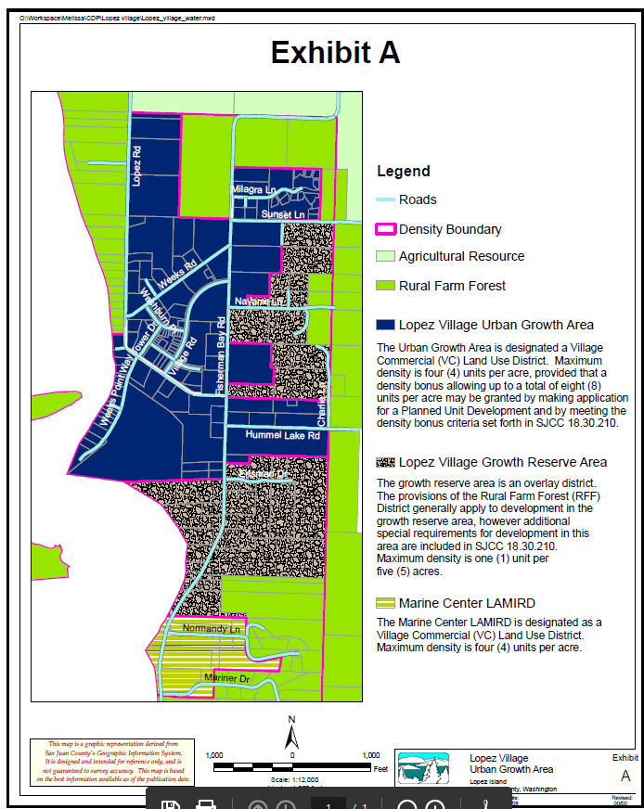
Land Use and Density Maps

Slide 8
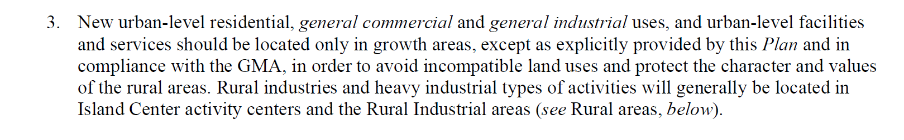
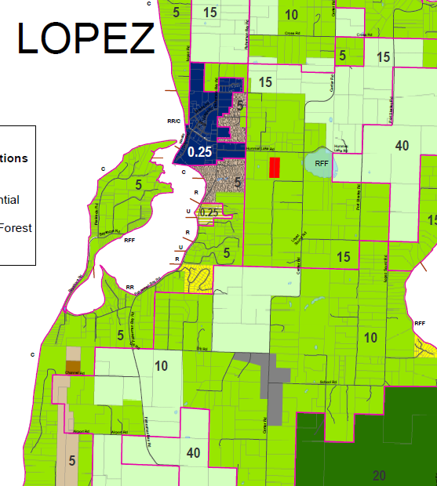

Slide 9
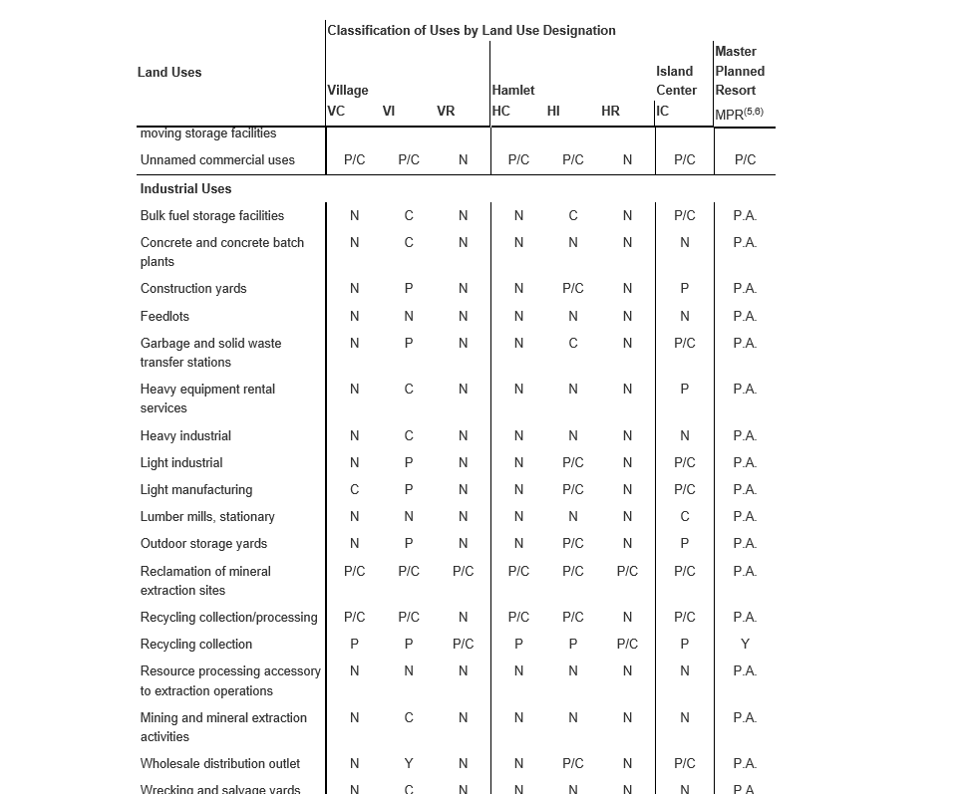
Development Regulations

Slide 10
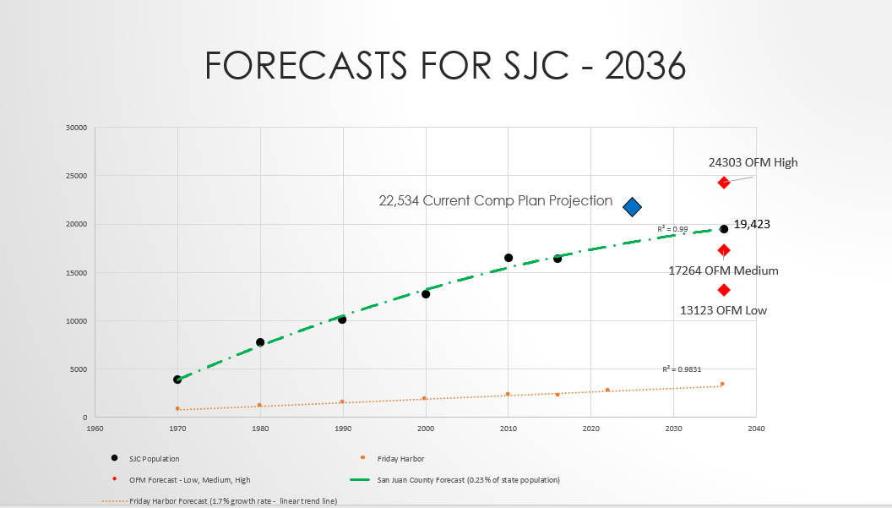
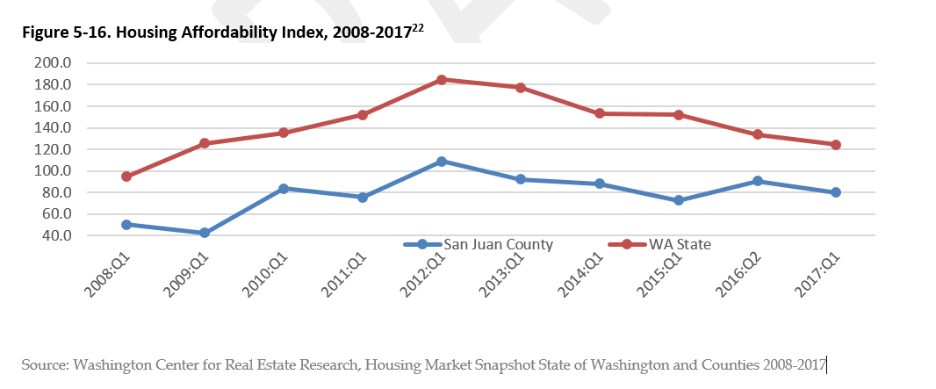
Data and Analysis

Slide 11
Where are we today?
In 2016 Council adopted a scope of work
Adopted a 2036 population forecast
Preliminary Draft Housing Needs Analysis
Preliminary Draft Capital facilities and Utilities inventories
Community vision, priorities and values outreach
http://sanjuanco.com/1079/Comprehensive-Plan-Update
Preliminary Land Capacity Analysis methodology:
http://sjcgis.maps.arcgis.com/apps/Cascade/index.html?appid=f81a3abaf81e40a494cede9b73e0c140

Slide 12
Future Population

Slide 13
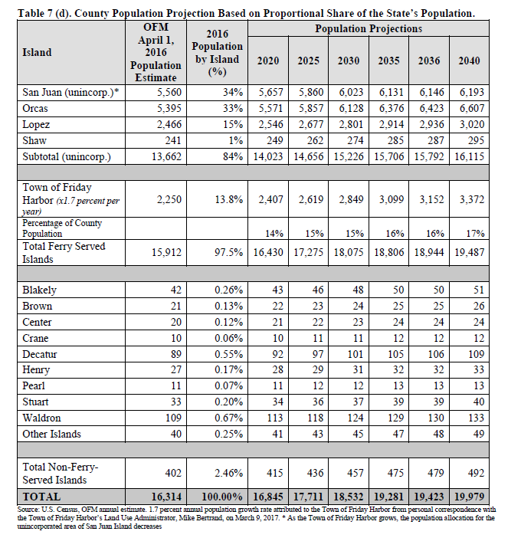
Population Distribution by Island

Slide 14
Housing Needs Analysis
Approximately 1,524 new dwelling units would be needed for a population of 19,423. 50% (809) of those dwellings planned for Urban Growth Areas.
As of 2015 there were 13,619 housing units in the county, of which 7,708 units were occupied.
Demographics:
Aging population
Declining school enrollment
Diversity- 84% of all housing units are single family units.
Affordability
2015 Median home price is $465,500, 2017 median income is $67,600
SJC 2017 housing affordability index (HAI) was 79.8. HAI of 100 + means that families with median income can afford a home.
Second/vacation homes – 43% of all housing units are for seasonal or occasional use.
Notes:
median age is 54 as compared to the median age in the State which is 38. In the year 2000, the median age was 47.
San Juan County is the least affordable county in the State.
3,100 households out of 7,708, or 40%, of total households are cost burdened - spending more than 30% of income on housing costs.
Average household size is 2.04.

Slide 15
SCHEDULE
March – December 2017
January – May 2018
May– July 2018
October 2018
Technical Memoranda
Population Forecast
Land Use Inventory
Land Capacity Analysis
Housing Needs Assessment
Capital Facilities Inventory
Preliminary Draft Goals and Policies
Vision
Land Use
Rural and Resource
Housing
Transportation
Capital Facilities/Utilities
Natural Environment
Planning Commission Hearing Draft
Release PC Review Draft
Council Hearing
Draft
Council Hearings
Release Council’s Public Hearing Draft
Environmental Review
Public Hearing
PC Recommendation
Council Briefings
Vision Update and Rural Vision
Agriculture & Forest Resource Land Analysis
Council and Planning Commission
General Public
Open Houses
Stakeholders and Interest Groups
Targeted Workshops
Briefings and Work Sessions, Planning Commission Public Hearing
Survey
Press Releases
Website
Hearings
Presentations to Interest Groups
Press Releases
Public Notices
Briefings and Hearings
Updated: 09/08/2017

Slide 16

Subscribe for Update News Visit the Project Website
Project website:
www.sanjuanco.com/1079/Comprehensive-Plan-Update
Subscribe to the project list to receive future notices:
www.sanjuanco.com/list.aspx (look for Comprehensive Plan Update under News Flash)

Slide 17

Questions?

