Slide 1
Planning Commission
January 19, 2018
Comprehensive Plan 2036 Update Work Session: Vision Amendment Recommendations
Adam Zack, Planner II

Slide 2
Purpose
Review existing Vision for potential amendments
Summarize public feedback from Vision Update 2036 report. Document link: https://www.sanjuanco.com/DocumentCenter/Home/View/13890
Generate Planning Commission direction for possible amendments
Notes:
Start with what we are here to do. We are here to review the current vision statement, get to know the feedback that was gathered in October and November, and for you to give me direction on the first draft of staff recommendations.

Slide 3
Process
Recap existing Vision elements
Recap key metrics from public engagement for each element
Grade, Gap, Priority
Provide direction on amendments
Notes:
The process we will use to determine directions will be to review the current Vision, I will go over the feedback we received, and then I will ask questions to get at the recommended direction.

Slide 4
Next Steps – February 16th Planning Commission Meeting
Presentation of draft amendments
Public comments on draft and PC discussion
Planning Commission refinement of recommendations
Notes:
Following this meeting today, staff will draft recommendations. These recommendations will be presented to the Planning Commission on February 16th. At this point the public will be able to comment on the recommendations and the discussion to that point. Then, Commission will be able to refine the recommendations.

Slide 5
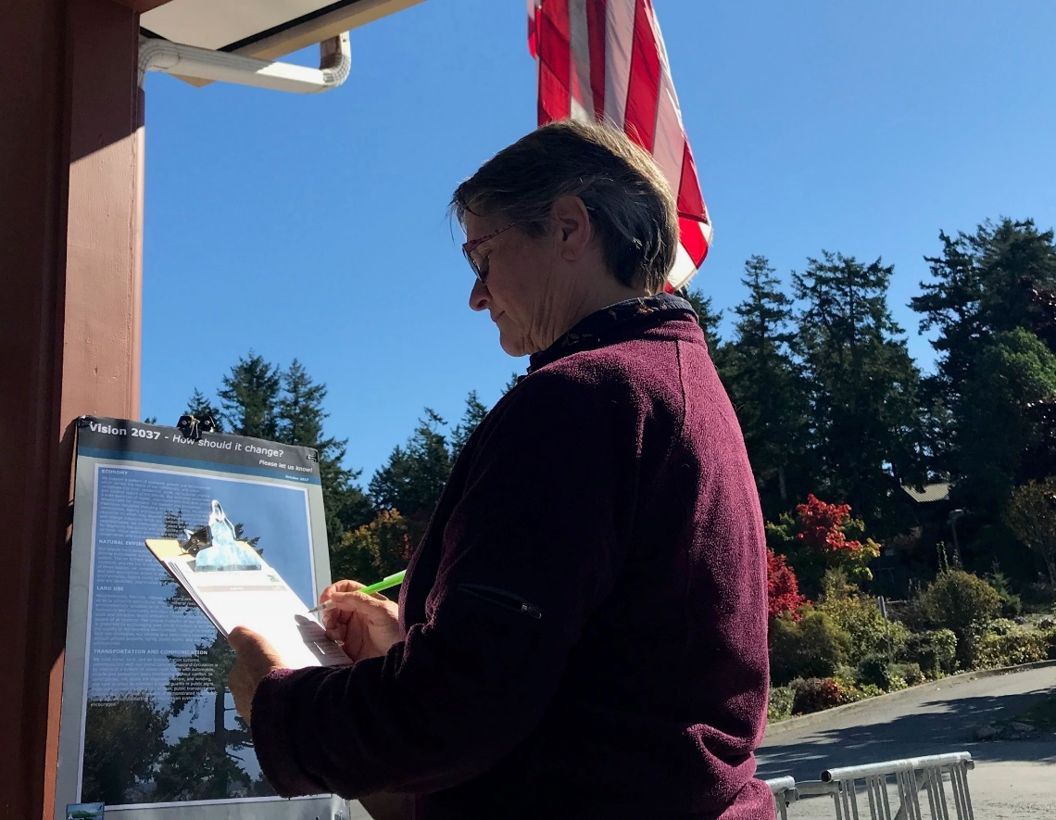
Grade
The grade reflects how the community views each component of the vision statement.
From survey, 100 point scale, the higher the grade, the more community confidence in that Vision Statement element.
Notes:
In the month of November DCD and Studio Cascade conducted an online survey. There were 560 responses to the survey. The questions were structured to get feedback on how well each element of the vision statement addressed the next 20 years. Respondents rated each statement on a one-hundred point scale, the higher the grade the more a respondent agrees with the statement. The result of this survey provided a grade for each statement. This metric is important because it reflects the community’s confidence in the content of each statement.

Slide 6
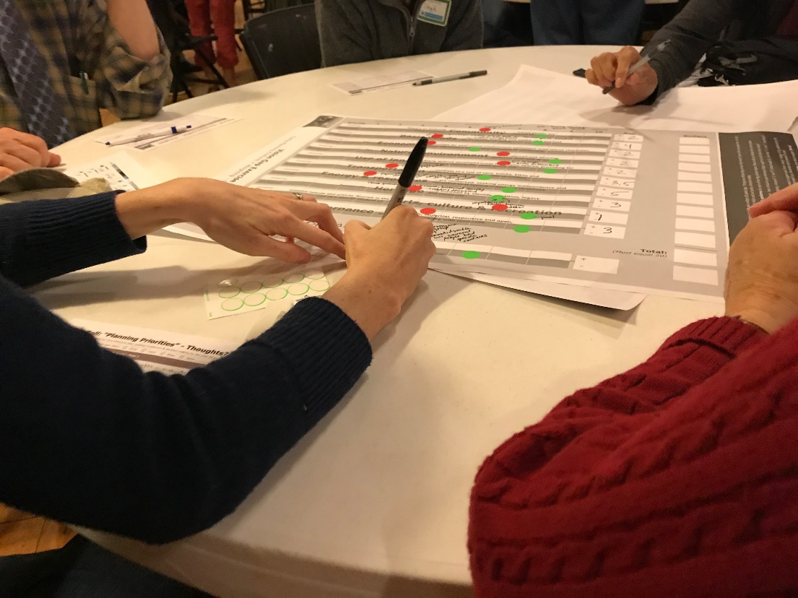
Gap
From the October workshops, groups used a 10 point scale to rate each statement element on where it is now and where it ought to be. The resulting difference is the gap.
(Future Aspiration)
– (Current Condition)
= Gap
Notes:
During the workshops in October, participants were asked to rate each element of the vision statement on a ten point scale. They rated based on ‘where we are now’ and ‘where we want to be in 2036’. The difference between the two scores is referred to as the vision gap. The gap reflects less on the specific content of each vision statement, representing more what issues the County needs to work on going forward.

Slide 7
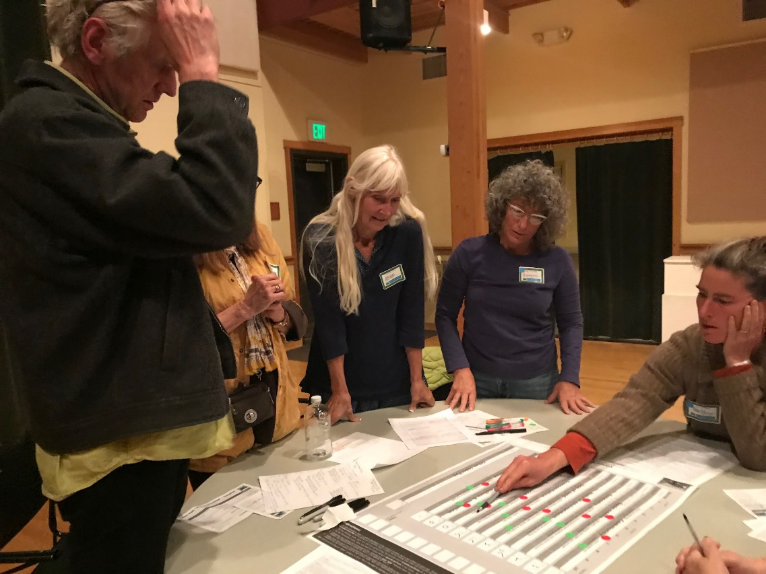
Priority
The priority indicates the level of needed resources each element requires.
From October Workshops. Groups applied limited resources to each statement element.
Notes:
If the gap identifies where the County needs to work, the priority shows how participants thought the County should focus resources. The higher the priority, the more time, effort and money respondents felt need to be invested to close the gap. This metric does not respond directly to the language of the Vision statement but rather suggests ways the policy agenda should be set.

Slide 8
Begin Work Session
Review existing statement element
Presented in order of lowest grade/higher gap
Recap key metrics for each element
Provide direction to staff
Notes:
The following process will be used to determine what amendments may need to be made to the Vision statement. I will provide the text for each element of the Vision statement and recap the grade, gap, and priority for each. Once we have reviewed the public input available, I will ask some questions to determine what, if any, amendments should be made to the Vision. It is worth noting that some of these statements may not need amendment and that some community concerns will be better addressed through goals, policies, and action items. The Vision statement is an aspirational statement that provides guidance for the goals, policies and actions outlined in the Comprehensive Plan. The Vision should outline where our community wants to go so that the Comprehensive Plan can create the way to get there.
Throughout the remaining work session I will refer to the SJC Vision 2036 Update Process report. There is a link to this document on the agenda. Please take a moment to open the report now.

Slide 9
BASIC NEEDS (Page 25)
Our islands are places where all citizens can safely walk or play, day or night. The drinking water supply is clean and adequate. Health care and help in time of need are accessible and affordable. The supply of affordable housing is adequate to meet the needs of our diverse population.
Notes:
Turn to page 25 of the Vision 2036 report. (read statement element)
(On return) fourth sentence refers to housing... Change needed? Second sentence refers to clean drinking water... Change needed? Third sentence referring to healthcare... Change needed?
If YES: does the language need to change? Does the structure need to change?
Is something missing from this statement? Does something more need to be added?
If no change... The community concern should be noted in the coming months as we update the goals, policies and action items of different Comprehensive Plan elements.

Slide 10
BASIC NEEDS (Page 25)
Lowest Grade 63/100
Highest Gap 4.39
Highest Priority 4.1
Core Issues
Affordable Housing
Safe Drinking Water
Access to Healthcare
Notes:
Basic Needs is the statement element with the lowest grade, highest gap and priority. Throughout the pop-up studios, workshops and the survey, respondents regularly pointed to this element as a major concern. The three main issues people are concerned about are affordable housing, safe drinking water and access to healthcare.
Affordable housing: the concern seems to be regarding affordability for all income ranges. Respondents often cited the challenges for working people to afford to live here. The affordability problem is seen as affecting most wage earners, not only lower income households. The issue of access to housing came up often, many working people have a hard time finding places to live.
Drinking Water: many residents are concerned about the availability of quality drinking water. Issues include saltwater intrusion to wells, adequate supply of groundwater, and the impacts of climate change.
Health care: residents expressed concerns about access to healthcare in the islands. A big concern is the availability of senior care for the islands’ aging population.

Slide 11
BASIC NEEDS (Page 25)
Is change needed?
Language?
Structure of statement?
Additional language, something missing?
Notes:
In light of the public concern, there are some questions we should answer about the Vision statement. Is a change needed? (return to vision statement text)

Slide 12
TRANSPORTATION & COMMUNICATION (Page 43)
We have water, land, and air transportation systems commensurate with our island culture. On-island circulation is by means of a system of scenic rural roads with automobile, bicycle and pedestrian ways functioning without conflict. In some places, the roads are unpaved, narrow, and winding, and care is taken to maintain a rustic quality in public signs. Expansion or new construction of basic public transportation facilities occurs only on the basis of demonstrated local public need. Advanced interactive communication systems are encouraged.
Notes:
Turn to page 43 of the Vision 2036 report. (read statement element)
(On return) second sentence refers to bike and pedestrian safety... Change needed? Fourth sentence refers to expansion and improvement of infrastructure... Change needed? Last sentence referring to interactive communication systems... Change needed?
If YES: does the language need to change? Does the structure need to change?
Is something missing from this statement? Does something more need to be added?
If no change... The community concern should be noted in the coming months as we update the goals, policies and action items of different Comprehensive Plan elements.

Slide 13
Transportation & Communication (Page 43)
Grade 71/100
Gap 3.9
Priority 2.4
Core Issues
Bike and Pedestrian Safety
Reliance on Car for day-to-day needs
Inclusion of Communication
Notes:
Transportation and Communication was the element with the second lowest grade and the second highest gap.
Many respondents expressed that they don’t feel safe as pedestrians or bicyclists on most roads. This was the second most common comment I heard during the pop-up studios and workshops.
There is a concern that reliance on cars in the islands will drive a scale of improvements that will jeopardize rural character.
Many respondents didn’t understand why communication was included in this element.

Slide 14
Transportation & Communication (Page 43)
Is change needed?
Language?
Structure of statement?
Additional language, something missing?
Notes:
In light of the public concern, there are some questions we should answer about the Vision statement. Is a change needed? (return to vision statement text)

Slide 15
ECONOMY (Page 31)
We support a pattern of economic growth and development which serves the needs of our community, and which recognizes the rural, residential, quiet, agricultural, marine and isolated nature of the islands. Our economy comprises a wide spectrum of stable, year-round activities that provide employment for islanders. We support and encourage traditional industries including forestry, farming, aquaculture, construction, fishing and tourism without jeopardizing the resources on which they depend. We have home occupations and cottage industries which are compatible with surrounding neighborhoods. We encourage new ideas and new technology for improving the quality and profitability of our goods and services. Value-added activities are encouraged. Environmental conservation and sustainable development are balanced.
Notes:
Turn to page 31 of the Vision 2036 report. (read statement element)
(On return) second sentence refers to stable year-round employment... Change needed? Third sentence refers to resource based sector... Change needed? Second sentence refers to tourism... Change needed?
If YES: does the language need to change? Does the structure need to change?
Is something missing from this statement? Does something more need to be added?
If no change... The community concern should be noted in the coming months as we update the goals, policies and action items of different Comprehensive Plan elements.

Slide 16
ECONOMY (Page 25)
Grade 75/100
Gap 3.4
Priority 2.5
Core issues
Housing affordability and workforce
Changes in resource-based economy
Impacts of tourism
Year-round, living wage jobs
Notes:
Economy had the fourth lowest grade, the fourth highest gap and third highest priority.
Housing came up often in regards to economy. The concern is that without affordable and available housing, employers are having a hard time filling positions. Challenges in housing the workforce is limiting economic growth. Access to housing is also leading many, including tradespeople and entry-level professionals, to settle for substandard or distant housing.
The resource based economy in the islands is changing. Respondents indicated that the statement may present an outdated view of this sector of the economy.
Respondents were concerned about the growth of lower-wage and seasonal jobs and the other economic impacts of the tourism industry. Focus was directed at the importance of stable, year-round jobs.

Slide 17
ECONOMY (Page 25)
Is change needed?
Language?
Structure of statement?
Additional language, something missing?
Notes:
In light of the public concern, there are some questions we should answer about the Vision statement. Is a change needed? (return to vision statement text)

Slide 18
ENERGY AND RESOURCES (Page 49)
Our community fosters resource and energy conservation. Energy independence is encouraged. Recycling, solid waste, and sewage treatment are managed within the confines of each island in an environmentally sound manner. Renewable natural resources are used on a sustainable basis. Nonrenewable resources are conserved wherever possible and practical.
Notes:
Turn to page 49 of the Vision 2036 report. (read statement element)
(On return) third sentence refers to recycling and waste are mentioned... Change needed? Climate change is not included... Change needed? Water resources are not included... Change needed?
If YES: does the language need to change? Does the structure need to change?
Is something missing from this statement? Does something more need to be added?
If no change... The community concern should be noted in the coming months as we update the goals, policies and action items of different Comprehensive Plan elements.

Slide 19
ENERGY AND RESOURCES (Page 49)
Grade 83/100
Gap 3.9
Priority 2.7
Core issues
Waste Reduction
Recycling
Water resources
Climate change not included
Notes:
Energy and resources has the third highest grade and the third highest gap.
Many comments received noted that there is no mention of climate change in this Vision element. This omission is one of the biggest areas that the conversation now differs from when the Vision statement was adopted. Climate change was not as big a concern twenty years ago when the Vision statement was drafted.
Water resources came up again in the discussion of this element. Many residents are concerned about the supply of fresh water and that the Vision statement doesn’t adequately address this vital resource.
Another concern is that there needs to be more of a focus on reducing waste and improving recycling.

Slide 20
ENERGY AND RESOURCES (Page 49)
Is change needed?
Language?
Structure of statement?
Additional language, something missing?
Notes:
In light of the public concern, there are some questions we should answer about the Vision statement. Is a change needed? (return to vision statement text)

Slide 21
NATURAL ENVIRONMENT (Page 35)
Our islands have exceptional natural beauty and healthy diverse ecosystems surrounded by pollution-free marine waters. The air is fresh and clean, the water quality is excellent, and the soil is uncontaminated. As careful stewards of these islands, we conserve resources, preserve open space, and take appropriate action to assure healthy land and marine environments. Native plants and animals of the islands thrive, and are identified, appreciated and conserved.
Notes:
Turn to page 35 of the Vision 2036 report. (read statement element)
(On return) second sentence refers water quality... Change needed? Climate change is not included... Change needed?
If YES: does the language need to change? Does the structure need to change?
Is something missing from this statement? Does something more need to be added?
If no change... The community concern should be noted in the coming months as we update the goals, policies and action items of different Comprehensive Plan elements.

Slide 22
NATURAL ENVIRONMENT (Page 35)
Grade 79/100
Gap 3.1
Priority 2.4
Core issues
Regional ecosystem fragility
Drinking water resources
Climate change not included
Link between natural environment and the economy
Notes:
Natural Environment is at about the middle in terms of all three metrics.
Much of the public concern is directed at preservation and conservation of the local ecosystem. Respondents are concerned that the unique natural systems on the islands may be damaged by human activity.
Drinking water quality again came up. Concerns over desalination and saltwater intrusion arose often.
Many comments pointed out that the natural environment has become key to the islands’ economic survival. Supporting life here and the tourism industry.
Climate change is not included in this statement.

Slide 23
NATURAL ENVIRONMENT (Page 35)
Is change needed?
Language?
Structure of statement?
Additional language, something missing?
Notes:
In light of the public concern, there are some questions we should answer about the Vision statement. Is a change needed? (return to vision statement text)

Slide 24
LAND USE (Page 39)
Neighborhoods, hamlets, villages and towns are clearly defined so as to conserve agricultural, forest, mineral resource and environmentally sensitive lands. These areas provide for commerce and community activities without losing their small scale and attractive island ambiance. There is housing for people of all incomes. The unique character of our shorelines is protected by encouraging uses which maintain or enhance the quality of the shoreline environment. Through innovative land use strategies, our citizens and institutions balance and protect private property rights, public rights, and our natural environment.
Notes:
Turn to page 39 of the Vision 2036 report. (read statement element)
(On return) first and second sentences refer to focusing development within ‘urban areas’... Change needed? The third sentence mentions housing for all people... Change needed? Rural character is not mentioned... Change needed?
If YES: does the language need to change? Does the structure need to change?
Is something missing from this statement? Does something more need to be added?
If no change... The community concern should be noted in the coming months as we update the goals, policies and action items of different Comprehensive Plan elements.

Slide 25
LAND USE (Page 39)
Grade 74/100
Gap 3.0
Priority 1.6
Core issues
Rural Character and Open Space
Housing
Existing levels of development pose challenges to growth management
Notes:
Land use has the third lowest grade and the fourth lowest gap.
Respondents pointed out that rural character is becoming less about resource lands and increasing about the aesthetics of the open fields and forests.
The availability of housing for year-round residents came up here as well. Support for increased supply of housing is accompanied with two caveats: additional housing should be developed to be compatible with and enhance the surroundings. AND new housing should not be placed at the expense of existing residents, i.e. diminishing water supply or damaging the natural environment.
Respondents are concerned about development sprawling into rural areas. In general, folks favor small, dense urban areas over suburban types of development.

Slide 26
LAND USE (Page 39)
Is change needed?
Language?
Structure of statement?
Additional language, something missing?
Notes:
In light of the public concern, there are some questions we should answer about the Vision statement. Is a change needed? (return to vision statement text)

Slide 27
GOVERNANCE (Page 55)
We are self-governed by informed citizens. We are equally represented by elected officials who conduct the activities of government in an ethical, fair, impartial, responsive and open manner which recognizes the independent, self-reliant nature of its citizens. Our government institutions balance responsibility with resources and costs, consolidate services where practical, manage prudently, provide reliable data, are service-oriented, and perform in a timely manner.
Notes:
Turn to page 55 of the Vision 2036 report. (read statement element)
(On return) first sentence refers to representation... Change needed? Public participation and citizen involvement not included... Change needed?
If YES: does the language need to change? Does the structure need to change?
Is something missing from this statement? Does something more need to be added?
If no change... The community concern should be noted in the coming months as we update the goals, policies and action items of different Comprehensive Plan elements.

Slide 28
GOVERNANCE (Page 55)
Grade 77/100
Gap 3.3
Priority 1.0
Core issues
Challenges in serving all islands
Transparency in decision making
Representation
Notes:
Governance had the fifth lowest grade and was near the middle in terms of gap.
Respondents acknowledged that the islands’ geography present logistical problems. Representation and inclusion in decision-making are greatly challenged given the remote nature of the outer islands. Many of the comments called for increased access to meetings and opportunities to participate.

Slide 29
GOVERNANCE (Page 55)
Is change needed?
Language?
Structure of statement?
Additional language, something missing?
Notes:
In light of the public concern, there are some questions we should answer about the Vision statement. Is a change needed? (return to vision statement text)

Slide 30
Remaining Elements
Community
Grade 81, Gap 2.5, priority 1.3
Report pg. 23
Education
Grade 79, Gap n/a, priority n/a
Report pg. 29
Arts, culture, & recreation
Grade 86, Gap 0.9, priority 0.4
Report pg. 51
Heritage and Historic Preservation
Grade 85, Gap 2.6, priority 0.7
Report pg. 53
Notes:
These four elements were graded relatively highly and/or had lower gaps. The indication is that these elements may not need amendment. Survey respondents were generally okay with these elements of the Vision. I have included the page numbers for each section of the report if you would like to take a look at any of these sections at this time.

Slide 31
Questions?
Next Steps: Review Recommendations February 16
Notes:
We will review the recommendations for amendment at the next meeting on February 16. If you have any questions or additional comments between now and then, you can send them to me at Adamz@sanjuanco.com.

Slide 32
Sign Up for Comp. Plan News Flashes https://www.sanjuanco.com/list.aspx
For more information, Contact:
Adam Zack, Planner II
Adamz@sanjuanco.com
(360) 370-7580

