Slide 1
Draft Lopez Village Plan, Development Regulations, Standard Plans and Implementation Plan
October 26, 2018 Planning Commission
Continuation of September 21, 2018 Public Hearing and Deliberations
Project Website: https://www.sanjuanco.com/909/Lopez-Village-Subarea-Plan

Slide 2
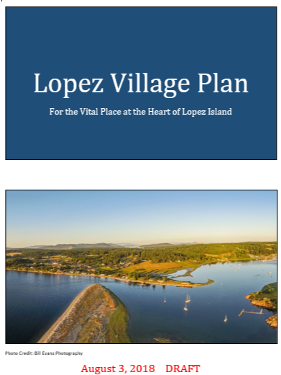
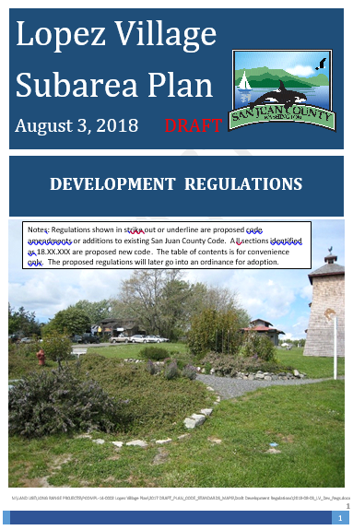
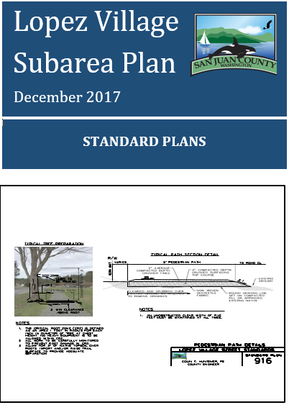
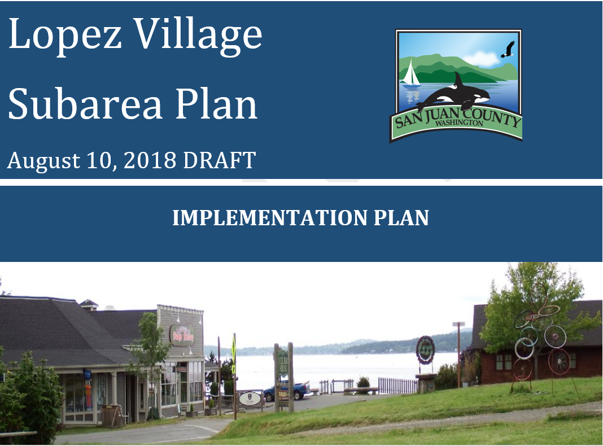
Presentation Overview
The County held a public hearing on the Lopez Village Planning and Review Committee drafts on September 21, 2018.
Time to Deliberate

Slide 3
Presentation Overview
September public hearing and staff review of public comments
Lopez Village Planning & Review Committee’s (LVPRC) October feedback
PC deliberation process – Review staff/LVPRC suggested changes
PC deliberations – address specifics & staff direction for consistency changes
PC versions and all proposed changes to the public hearing drafts will be noticed prior to Council’s continued hearing

Slide 4
Comment Review
Staff reviewed comments and summarized for the LVPRC
Met with the LVPRC on October 12, 2018
Both September 7 and October staff report contains LVPRC recommendations
Staff consolidated proposed changes identified in the September and October staff reports in this presentation

Slide 5
Next steps
Planning Commission: Make recommendation to Council
Staff prepares PC recommended drafts
Staff briefs Council and prepares SEPA/Ordinance
All proposed changes specifically advertised
Final County Council public hearing and consideration

Slide 6
Suggested deliberation process
General questions/answers
Give due consideration to LVPRC expertise and recommendation
Review staff and LVPRC recommended changes
Discuss other Planning Commission changes
Make recommendation

Slide 7
Review of Proposed Changes
Review staff and LVPRC proposed changes outlined in the September and October staff reports:
https://www.sanjuanco.com/DocumentCenter/View/16868/2018-09-07_Staff-Report-for-Lopez-Village-Plan-Public-Hearing-on-09-21-18
https://www.sanjuanco.com/DocumentCenter/View/17102/2018-10-15_DCD_Kuller_Staff_Rep_LVPlan_PC_10-26-18
Proposed changes are presented on the following slides.
If multiple people made the same comment, it is presented once.

Slide 8
Staff and LVPRC Recommendations
Map changes in Draft Plan
Map 2 Tree Planting - revised with an insert of the UGA, Page 25
Map 7 Connectivity - revised with an insert of the UGA and to extend the paths on Fisherman Bay and Lopez roads to the UGA extent, Page 46
Map 8 Parking Entitlement Area Map, Page 48
Include an insert of the UGA (October 15th staff report)
Re-label the original map to (8)(a) and add map (8)(b) (parallel parking)
to allow flexibility for stormwater improvements
Amend the text on Page 47 to reflect the additional map
Correct name in list of maps to Parking Plan with Entitlement Area

Slide 9
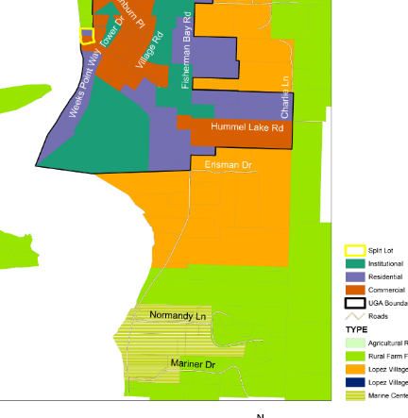
Staff Recommendations
Map changes in Draft Plan
Do not split TPN 251550011000 located
at 315 Lopez Road into two land use
designations: Village Commercial and
Institutional
For more details:
See September staff report Page 2)

Slide 10
Consistency Changes – Page 21
Village Commercial
A part of the heart of the Village, the Village Commercial designation recognizes the importance of a vital commercial and mixed-use core, not only in terms of economic value, but also as an essential expectation of Island residents. This traditional village core includes elements of land use diversity, neighborhood compatibility, pedestrian-friendly design, and public gathering spaces. Mixed-use (work-live spaces) are allowed. This designation retains commercial uses on the west side of Fisherman Bay Road.
Village Institutional
The heart of the Village also includes areas designated Village Institutional that support aspects of the public health, social and service needs of the community. These areas are primarily located west of Fisherman Bay Road.

Slide 11
Correction
Change Puget Power to Puget Sound Energy on Page 65, Lines 6 and 7 of the draft plan

Slide 12
Correct political sign code
Page 44, Lines 25- 27 of proposed development regulations: 18.XX.XXX Signs.
A. The following signs are exempt from the regulations contained in subsections B through D:
Signs required by law, and flags of national and state governments.
“No Hunting” and “No Trespassing” signs smaller than two (2) square feet.
3. Political signs. that are erected no more than forty-five (45) days prior to an election and are removed by the candidate or landowner no more than seventy-two (72) hours following an election terminating candidacy. Political signs shall not exceed six (6) square feet in area.

Slide 13
Mobile food vending units.
The September staff report suggested edits. Staff and LVPRC propose another proposal after considering public comments to prevent duplication of health codes:
Mobile food vending units:
Are permitted at temporary events pursuant to SJCC 18.80.060 and as specified in SJCC 18.XX.XXX); Note: land use table, Page 31 of draft regulations.
May be located on private or public property except as prohibited by the street vending regulations in Chapter 5.08 SJCC;
Shall comply with the County’s food service health regulations in Chapter 8.04 SJCC and State health regulations in Chapter 264-215 of the Washington Administrative Code; and
Must be placed at least five (5) feet from driveways, sidewalks, utility boxes, accessibility ramps, and building entrances or exits.

Slide 14
Road and Driveway Regulations
See Pages 3 and 4 of October 15, 2018 staff report
Based on Eastsound regulations - difficult to implement.
Triggers for requiring frontage improvements are confusing.
Staff, LVPRC and Co. Engineer propose replacement of the draft code section.
New proposal is clear & uses an impact based determination of when and what frontage improvement would be required.
Also includes adoption of standard plans.

Slide 15
Road and Driveway Regulations
The County Engineer would make that determination based on a traffic study required in SJCC 18.60.090(A)(6):
6. A traffic study based on the most current edition of the Highway Capacity Manual shall be performed for any proposed development that will result in an increase of 100 or more one-way trips per day onto a County road, inside or outside of an activity center or urban growth area. Inside of an activity center or urban growth area, all intersections that may be affected by the proposed development must be included in the traffic study. The number of one-way trips to be generated by the development shall be as is defined in the most current edition of the Institute of Transportation Engineers (ITE) Trip Generation

Slide 16
Road and Driveway Regulations
Except as modified by this section, the public road standards in SJCC 18.60.090 and private road standards in SJCC 18.60.100 shall apply within the Lopez Village urban growth area.
B. The County engineer shall determine the public road frontage improvements required after review of the traffic study required by SJCC 18.60.090(A)(6).
All development(s), which will affect the service level, safety or operational efficiency of the County public road system in Lopez Village, are responsible to mitigate said impact. The responsibilities of the developer are to be determined by the County before development approval. The responsibilities depend on the condition of the impacted road system, which is described by the level of service (LOS) and defined in the current edition of the Highway Capacity Manual. All improvements shall be made in accordance with the Lopez Village urban growth area standards.
The responsibility of the developer is to construct frontage road improvements and, where applicable, dedication of the required rights-of-way for public roads adjoining the property. Other responsibilities include such roadway elements as sight distance, roadway width, surface condition, and other structural/functional elements that must be improved to assure that following development the road will function at the prescribed LOS. If the LOS falls below LOS identified in the SJC Comprehensive Plan, the developer is to mitigate direct impacts of the development on public streets and intersections.
A building permit will only be issued when all funding mechanisms necessary to improve the road condition(s) are committed. Occupancy of the development may only occur after the required road improvements are completed.

Slide 17
Road and Driveway Regulations
4. Required roadway improvements may include traveled way or shoulder widening, addition of turn lanes, structural roadway repairs, signalization, sign installation, lighting, and/or bicycle and pedestrian facility installation or improvements. Additionally, a voluntary contribution to scheduled programs may be mutually agreed upon between the developer and the County engineer.
D. The County council may adjust the Lopez Village urban growth area standard plans by adopting an improvement plan for a specific street.
E. Property owners may request a modification of the Lopez Village urban growth area standard plans by submitting a request in writing to the department. The County engineer may recommend a modification of the standard plans for public or private roads. The decision shall include findings demonstrating the need and rationale for the modification.
F. Proposed modifications, revisions or additions to Lopez Village urban growth area standard plans shall be presented to the department and Lopez Village Planning and Review Committee for review and comment prior to approval by the County engineer and council.
G. Unless there is no feasible alternative, shared driveway access to more than one (1) property is required.
Note: Move the following to the proposed code section on parking (Page 48) of the draft regulations: On-street parking requirements in the Lopez Village Parking Plan with Entitlement Area Map 8 are addressed in section X of this ordinance (Lopez Village parking requirements).

Slide 18
Road and Driveway Regulations
C. The following Lopez Village standard plans approved by the County engineer shall be used to construct public road frontage improvements in Lopez Village urban growth area:
STANDARD PLAN NO. | DESCRIPTION | NOTES
911 | Typical Street Sections | No parking and parallel parking
912 | Typical Street Sections | 45 angle parking and main arterial
913(a) and (b) | Parking Layout | Alternative b allows for pervious concrete and street sweeping
914 | Pedestrian Crossing Layout | With crosswalks
915 | Streetscape Details | With driveway
916 | Pedestrian Path | Specifications
917 | Pedestrian Bridge Requirements | Material Concepts

Slide 19
Standard Plans
At a special meeting on August 10, 2018, to discuss new stormwater grants the LVPRC voted to recommend changes to Standard Plan #912 to accommodate new stormwater plans:
Standard Plan 912(a) and 912(b) were provided at the September 21 public hearing. Standard plan 912(B) provides a pervious concrete option.

Slide 20
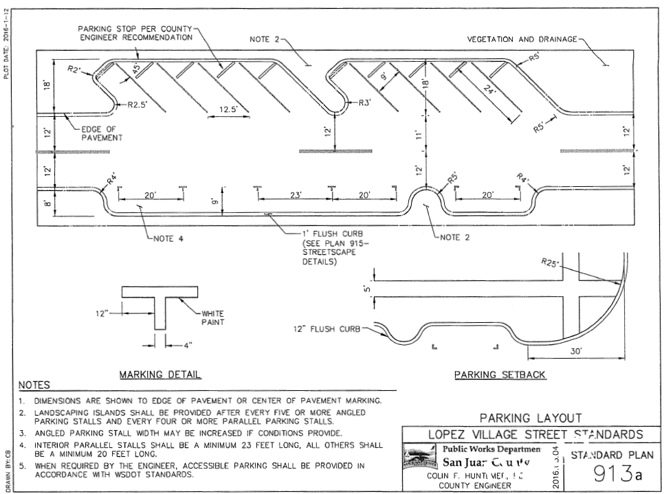

Slide 21
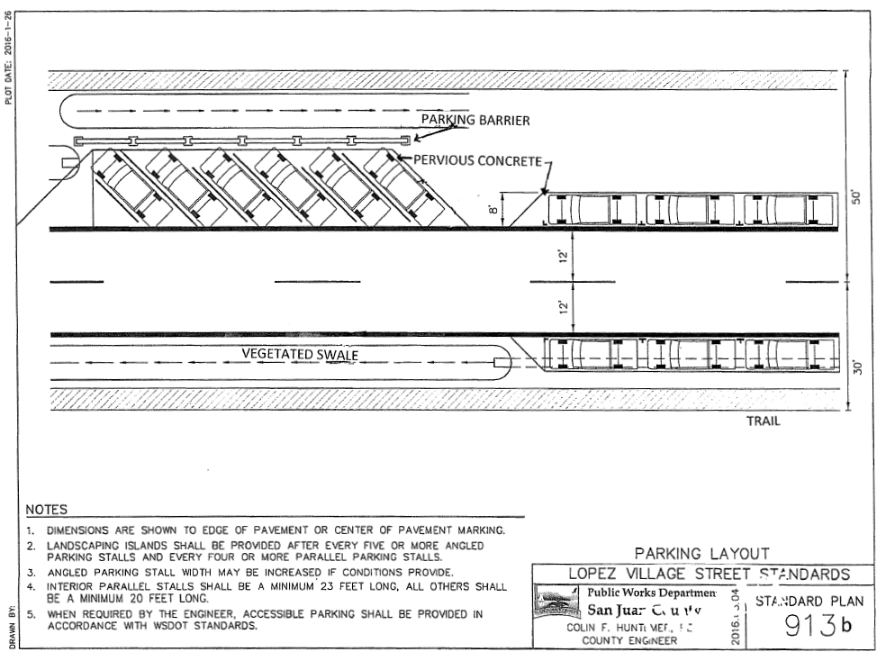

Slide 22
Implementation Plan Revisions
LVPRC recommended these changes to the draft implementation plan at their August 10, 2018 meeting after hearing from Public Works and Port of Lopez:
Add a project suggested by the regarding access to Lopez Village; and
Revise the stormwater projects to reflect those proposed by Public Works after receiving grants for some capital improvement projects
These proposed changes are in attachment D to the September staff report.

Slide 23
General LVPRC Recommendations
The LVPRC recommended the following additions to the plan. At this point, staff makes the following recommendations:
Executive summary - prepare this summary as an implementation bulletin after the final plan and regulations are adopted; and
How to use this plan – develop this tool as an implementation bulletin.

Slide 24
LVPRC Feedback On Sept. Hearing
1 | Commenter's Suggested Changes - Mitchell | LVPRC Recommendation October 12, 2018
 | Add a policy requiring a habitat buffer around certain number of homes (8?) to eliminate potential for dense neighborhoods that loose rural tranquility. Density bonus of 7-8 units per acre is suggested as better. | No change.

Slide 25
LVPRC Feedback On Sept. Hearing
4 | Commenter's Suggested Changes - Pascuito | LVPRC Recommendation October 12, 2018
Make exceptions to non-safety requirements for affordable housing. | Allow a variance/deviation from pervious parking requirements in proposed 18.30.XXX Lopez Village parking requirements item (L): Except for parking lots proposed in permanently affordable housing projects, Aall uncovered on-site parking lots of five (5) or more spaces in the village commercial and institutional designations shall be designed and installed using pervious surfaces. Page 67 of the draft regulations.

Slide 26
LVPRC Feedback On Sept. Hearing
5 | Commenter's Suggested Changes Porter and others | LVPRC Recommendation October 12, 2018
Remove beach rocks – Add to implementation plan and policies? | Add beach restoration to implementation list: Beach restoration projects are encouraged on all Lopez Village beaches.

Slide 27
LVPRC Feedback On Sept. Hearing
6 | Commenter's Suggested Changes - Porter | LVPRC Recommendation October 12, 2018
Consider other locations for docks. | No change. Implementation plan says: Explore options for marine facilities that would provide access to Lopez Village. It does not say docks. It would consider kayak/canoe access, etc.

Slide 28
LVPRC Feedback On Sept. Hearing
8 | Commenter's Suggested Changes – Wilburn | LVPRC Recommendation October 12, 2018
Modify Map 1 Viewsheds to extend the viewshed over the entire UGA to protect the viewshed from the E side of Fisherman Bay Road. Page 20 Modify Map 2 Tree Planting Plan to eliminate the proposed trees along Fisherman Bay Road. Page 26 | No change is recommended. The viewshed is unlikely to be affected. The proposed trees were intended to have a traffic calming effect on Fisherman Bay Road. There is no plan for the development yet and most issues could be resolved.

Slide 29
LVPRC Feedback On Sept. Hearing
9 | Commenter's Suggested Changes - Wilburn | LVPRC Recommendation October 12, 2018
Remove path to nowhere across Wilburn property and Fisherman Bay Road - Map 7 Connectivity, Page 46 Change land use designation for Wilburn to Village Commercial on Map 5 Land use, Page 31 | No changes are recommended. The LVPRC did propose allowing neighborhood enterprise use in all Village Residential designations as a conditional use.

Slide 30
LVPRC Feedback On Sept. Hearing
10 | Commenter's Suggested Changes - Wilburn | LVPRC Recommendation October 12, 2018
Designate the entire Village as a new land use designation of Village Mixed Use | No changes are recommended. The LVPRC did propose allowing neighborhood enterprise use in all Village Residential designations as a conditional use.

Slide 31
LVPRC Feedback On Sept. Hearing
13 | Commenter's Suggested Changes - Miller | LVPRC Recommendation October 12, 2018
Do not restrict a huge section of the Village to Village Residential. | Change the land use table and notes to allow Neighborhood Enterprises in the Village Residential designation with a Conditional Use Permit. See October staff report. This is a change to the development regulations.

Slide 32
LVPRC Feedback On Sept. Hearing
17 | Commenter's Suggested Changes - Angel | LVPRC Recommendation October 12, 2018
Expand the existing commercial zoning south along Fisherman Bay Road at Hummel Lake Rd for 2262 and 2290 Fisherman Bay Road (Weeks garage and barn). Map 5 Land Use, Page 31 | No change is recommended. The existing residential property is proposed to be Village Residential.

Slide 33
LVPRC Feedback On Sept. Hearing
20 | Commenter's Suggested Changes - Friends | LVPRC Recommendation October 12, 2018
Add a goal and policy to Natural Systems and Habitat (Plan pages 72 & 73): Goal 7. Protect and enhance significant marine shoreline habitat in the Lopez UGA. Policy 7a. Collaborate with landowners and other partners to protect and enhance Village shoreline habitats through land conservation, habitat restoration and other means. | LVPRC recommends adding this goal and policy to the draft plan.

Slide 34
LVPRC Feedback On Sept. Hearing
21 | Commenter's Suggested Changes - Friends | LVPRC Recommendation October 12, 2018
A wetlands specialist is needed for Innisfree Land Trust area before proposing an increase in potential dwelling units. Concern with stormwater and filling in wetlands. adjacent to two (and potentially three) class A wells; Milagra Water System. | No change is recommended.

Slide 35
LVPRC Feedback On Sept. Hearing
22 | Commenter's Suggested Changes - Foley | LVPRC Recommendation October 12, 2018
Prohibit copper roofs which can pollute the Bay. | Yes, add a prohibition of copper roofs to prevent polluted run-off to development regulations. This would need to be a new code section

Slide 36
LVPRC Feedback On Sept. Hearing
23 | Commenter's Suggested Changes -Verbal - Multiple | LVPRC Recommendation October 12, 2018
Map 1 Viewsheds, Page 20 needs a legend. What do colors mean? | Change the viewshed map to have arrows directed at Fisherman Bay and make all of the viewshed highlights blue, the same color.

Slide 37
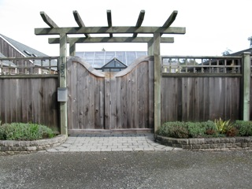
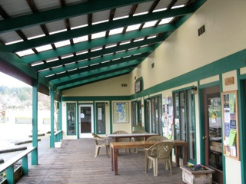
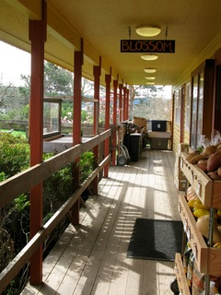
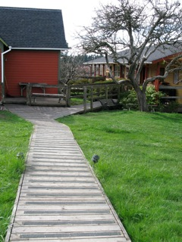
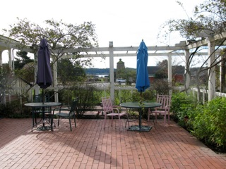
Lopez Village Plan

