Slide 1

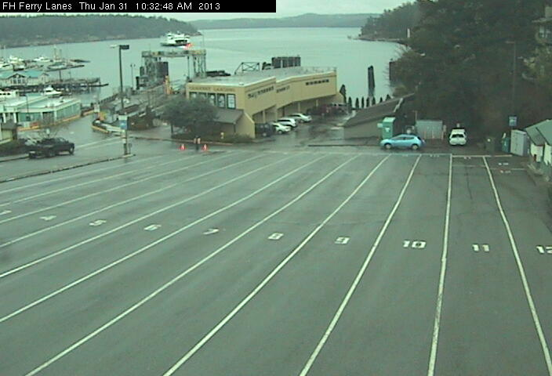
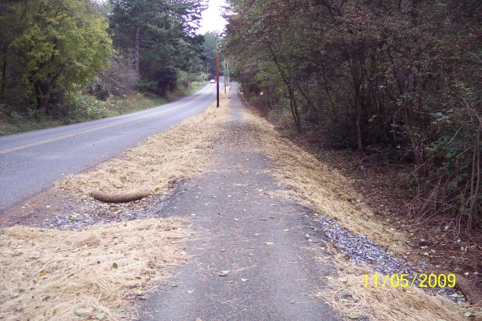
San Juan County Comprehensive Plan Update Transportation Element (TE) Preliminary Briefing
SJC Planning Commission
July 19, 2019
July 5, 2019 staff report:
https://www.sanjuanco.com/1306/Comprehensive-Plan-Elements

Slide 2
Background Briefing Purpose
To prepare you to review updates to the Transportation Element and make future recommendations about transportation goals, policies, and levels of service that will support the Vision & future land use assumptions.
Familiarize you with the Transportation Element/Appendices;
Inform you of Growth Management Act requirements;
Provide basic background on Level of Service (LOS);
Make you aware of:
current policy and code issues;
work progress; and
next steps.

Slide 3
Transportation Element Overview
Tool: shape development patterns, manage levels of congestion and the character of urban growth areas (UGAs).
Direction: development of systems, facilities, & improvements through 2036.
Consistent with and implements: Land Use Element.

Slide 4
SJC Transportation Element
Two parts:
Section B, Element 6: Goals and policies.
Appendix 6: Inventories, traffic forecasts, and levels of service.

Slide 5
Previous Updates
Last 10-year update: Ordinance 21-2013.
Ordinance 12-2016: Addressed Nonmotorized components:
Moved specific inventories, goals & policies into the Parks, Trails, Natural Areas and Nonmotorized Plan, and
Retained general policies in the Transportation Element.
Nonmotorized = pedestrian/bicycle

Slide 6
Growth Management Act

Slide 7
Growth Management Act
Transportation is a mandatory element.
Promote safe and efficient movement of people by:
Assessing the existing transportation system, and
Identifying & integrating alternatives to enhance the system.

Slide 8
Growth Management Act Plan Elements Must Be….
Consistent with relevant county-wide planning policies (Comp Plan Appendix 2) and the GMA;
Consistent with Comp Plan elements and the development regulations; and
Coordinated with Town and regional plans.

Slide 9
GMA Minimum Planning Requirements
Inventory: air, water, ground, state, general aviation, & ports
Land Use Assumptions: estimate travel consistent with Land Use
10-year Traffic Forecast: based on the Land Use Element
Trans. Demand Management Strategies: transit, taxi & shuttle service, and senior service vans
Levels of Service: regionally coordinated local arterials & transit
Future Needs: identify demand
Funding Analysis: capacity to meet needs vs. funding resources
Funding: multi-year financing plan to meet needs: 6-year TIP
Shortfall Strategy: to ensure that LOS standards will be met
Goals and Policies: All modes
Intergovernmental Coordination

Slide 10
Level of Service (LOS) and Concurrency

Slide 11
LOS Standards - WA Dept. of Commerce: Your Community’s Transportation System
LOS standards translate transportation and land use goals and policies into specific, measureable operational expectations.
Methods used to measure and maintain adopted LOS standards reflect values and policy decisions based on public participation.

Slide 12
Growth Management Act: LOS Standards
They should:
reflect goals: access, mobility, or capacity, & land use.
balance community character, funding capacity & expectations.
They are used to identify future system needs.

Slide 13
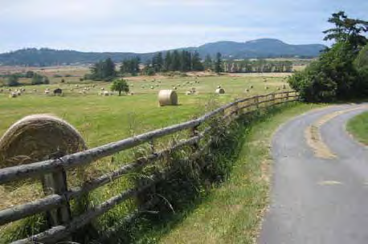
Growth Management Act: LOS Standards
LOS Required: Locally owned arterial streets & transit.
GMA does not: mandate a specific LOS or how to measure it.
Local policy choice: intersection LOS in UGAs.

Slide 14
Level of Service Standards - Ratings
LOS is a performance indicator.
It rates service quality from A (best) to F (worst).
LOS helps people to identify problems & prioritize improvements.
Urban areas have different LOS standards than rural areas.

Slide 15
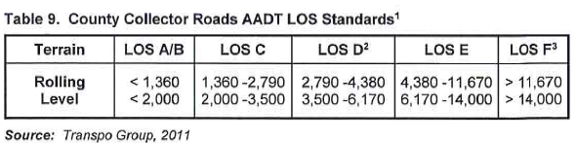
Roadway Level of Service Standards: Tool used to assess, plan & design improved facilities
Uses data to measure traffic conditions over a range of operational conditions.
Considers factors like speed and travel time, freedom to maneuver, traffic interruptions, and comfort.
TE Appendix 6, Page 32

Slide 16
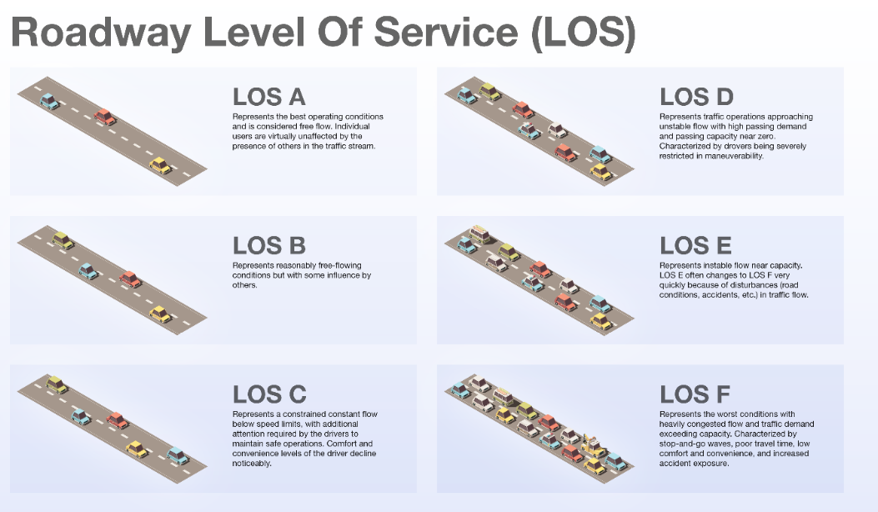
Roadway Level of Service

Slide 17
Intersection Level of Service How long does it take to cross an intersection?
Grade intersection operations as A, B, C, D, E, or F based on the amount of time each vehicle has to wait to go through the intersection during a particular hour.
Is measured in average vehicle delay time.

Slide 18
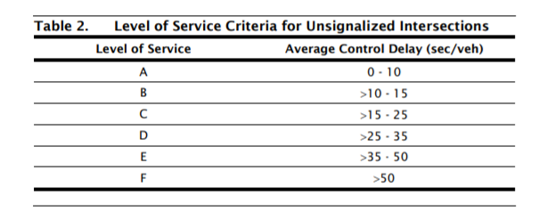
Intersection Level of Service 2000 Highway Capacity Manual

Slide 19
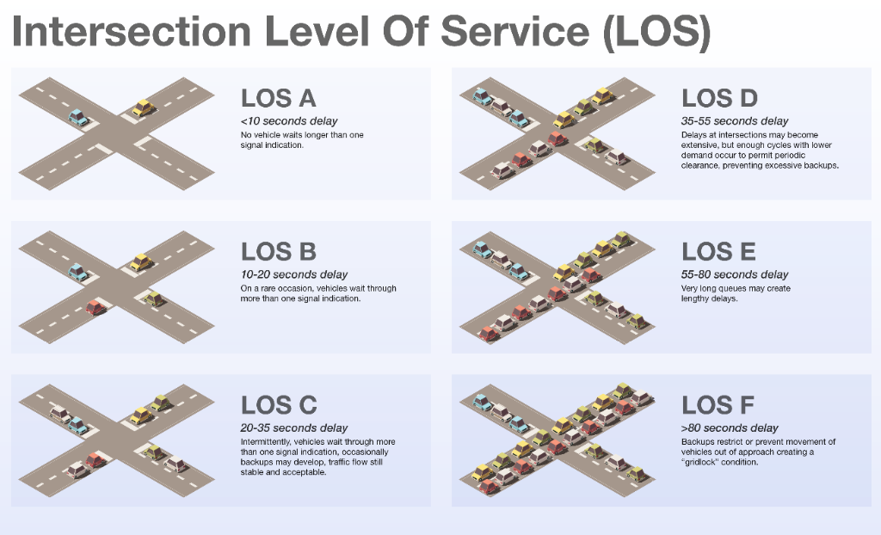
Intersection Level of Service

Slide 20
SJC Transportation Element 6.5.C LOS Policies for Land Transportation
2. Establish LOS standards for collector roads and UGA and Activity Center intersections based on Ave. Annual Daily Traffic volumes (AADT).
3. Establish LOS D as adequate for County collector roads.
Peak travel hour when average vehicle operating speeds drop to 35 MPH, platoon sizes are 5-10 vehicles and 75% of motorists are delayed by congestion or slower vehicles.

Slide 21

Adopted Level of Service Standards
Docks (Types 1 and 2), and
Collector roads (2000 Highway Capacity Manual).
SJC has not adopted LOS standards for SJC intersections.
County’s highway = ferry system. Ferry LOS is set by WA. State.

Slide 22
SJCC 18.60.220: Codifies SJC’s Adopted LOS
Table 6.6. Concurrency Requirements for Transportation Facilities
Concurrency Facility | Standard for Adequate Level of Service (LOS)
Washington State Ferry Service | WSF Level 2
County Collector Roads | Average Annual Daily Traffic (AADT)
Rolling Terrain | D – 2,790 to 4,380
Level Terrain | D – 3,500 to 6,170
County Docks – Type 1 | C – 0.60 to 1.19 lineal feet/seasonally adjusted dwelling units in service area
County Docks - Type 2 | D – 0.40 to 0.59 lineal feet/seasonally adjusted dwelling units in service area

Slide 23
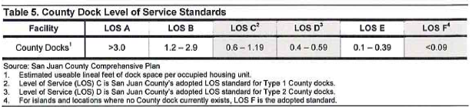
County Dock Level of Service Based on the estimated lineal feet of dock space per occupied housing units within the service area
Type 1: Docks on ferry served islands which provide primary access for non-ferry served islands;
Type 2: Docks on non-ferry served islands with County Roads; and
Type 3: Docks that that provide recreational uses or access between ferry-served islands (entire County, no concurrency)
TE Appendix 6

Slide 24
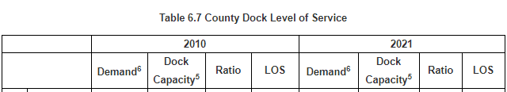
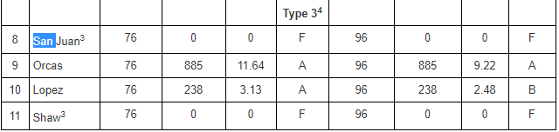
Type 3 Docks San Juan, Orcas, Lopez & Shaw
4: No concurrency for Type 3 Docks

Slide 25
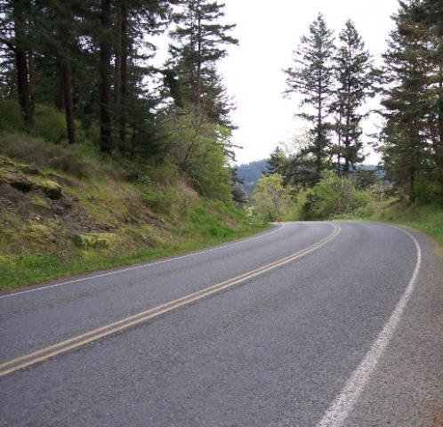
Concurrency: Providing Public Facilities and Services Sufficient to Meet Demand
Local governments are charged with ensuring that adequate public facilities (roadways, marine facilities, parking, and transit) meet the needs of development as it occurs or within a specified time period.
Concurrency brings locally owned facilities and services that fall below an established LOS standard into compliance when development permits are proposed.

Slide 26
Recent Development Pressure
SJC road standards: Require a traffic study assessing intersection impacts for proposals in Activity Centers and UGAs that add 100+ round trips per day onto a County road.
Traffic studies in UGAs discussed impacts to intersections and roadway functionality (Lopez Landing subdivision and OPAL).
Without policy & intersection LOS, the County cannot require developer improvements to address development impacts.
Road and concurrency codes: should ensure that intersection improvements are concurrent with development impacts.

Slide 27
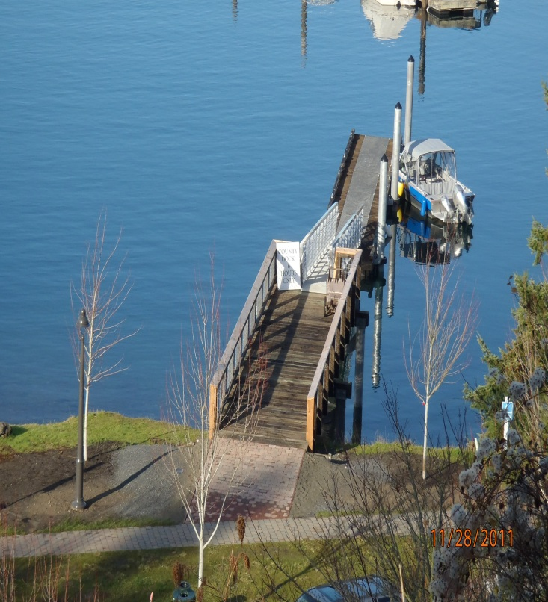
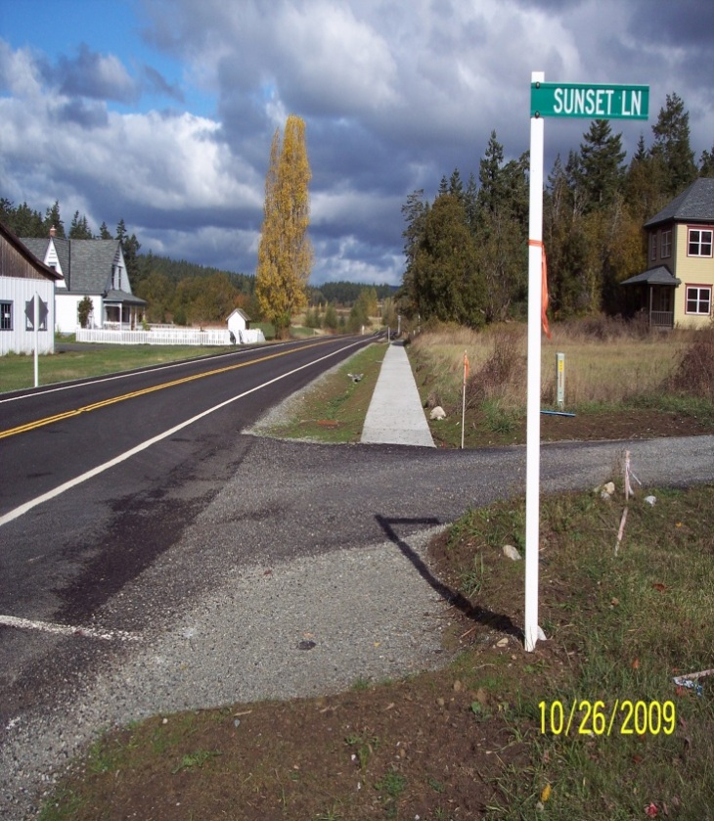
Progress Report

Slide 28
Preliminary Tasks: Drafts Ready for Internal Review
Updated inventories, traffic counts and data;
Updated WSDOT Ferry 2040 Long Range Plan;
Updated SJC port long range plans;
Added Complete Streets Program;
Removed ref. to Skagit-Island Regional Transp. Plan. Org.;
Analyzed existing LOS criteria; and
Incorporated some early public comments.

Slide 29
Next Steps:
Finish assessing data and public comments;
Complete internal review;
Briefing on the draft inventories and information updates;
Prepare for transportation/land use policy discussions;
Develop public engagement strategies and present issues;
Respond to comments – update drafts; and
Draft concurrency code updates, if needed for consistency.

Slide 30
Questions?

Slide 31
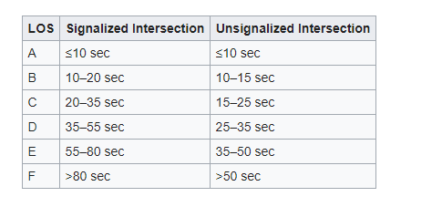
Intersection Level of Service

Slide 32
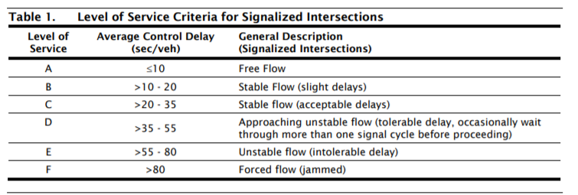
Intersection Level of Service 2000 Highway Capacity Manual

