Slide 1

Capital Facilities Inventory
Second Draft
Sophia Cassam, Planner I
October 18, 2019—Planning Commission
October 21, 2019—County Council
Comprehensive Plan Periodic Update

Slide 2
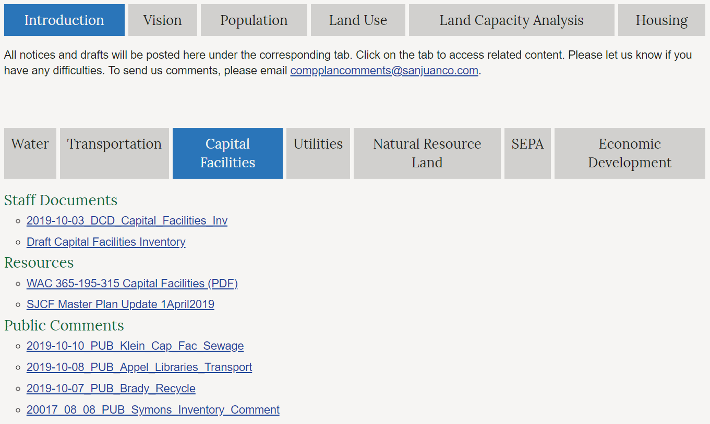
Comment on Capital Facilities
Comment Period End:
November 1st, 2019
Document Link:
http://www.sanjuanco.com/1306/Comprehensive-Plan-Elements
Submit Comments to:
compplancomments@
sanjuanco.com
Review draft here
Note: Substantive changes to draft made in strikeout/underline.

Slide 3

GMA Requirements
Mandatory Update
Now
Next
Inventory (Locations and Capacities)
Level of Service (LOS) analysis
Forecast of future needs
Proposed locations and capacities
6-year financing plan
Capital Facilities Element with Goals & Policies

Slide 4
Connections to other Plan Elements
WHAT
Capital Facilities
WHERE
Land Use
HOW
Economic Development

Slide 5
What is in the Inventory and Why?
Capital Facilities are…
Owned or operated by
San Juan County
Independent Taxing Districts
Public/Private Service Organizations
  Consistent County funding
Necessary to support future development
Subject to County-set LOS standards

Slide 6
Category B
Category A
CONCURRENT with development
Solid waste and recycling
Community water systems
Sewage treatment systems
NOT CONCURRENT with development
County government services
Parks and recreation
Public schools
Fire protection and EMS
Hospital districts
Senior services
Educational and recreational services (public libraries, museums, performing arts, community college)
concurrent with development
“means that improvements or strategies are in place at the time of development, or that a financial commitment is in place to complete the improvements or strategies within six years.” RCW 36.70A.070

Slide 7
Clarifying Capital Facilities
Definition
Category A & B
Taxing Districts
Taxing District | Island(s) Served | Capital Facility Funded
State Levy Part 1 | All | Public Schools
State Levy Part 2 | All | Public Schools
San Juan Island School District | San Juan, Pearl, Henry, Brown and Stuart | Public Schools
Port of Friday Harbor | San Juan | Ports
San Juan County fire protection district #3 | San Juan, not including the Town of Friday Harbor | Fire Protection
San Juan County fire protection district #6 | Stuart | Fire Protection and EMS
San Juan Island library district | San Juan | Education and Recreation
San Juan Island park and recreation district | San Juan, including town of Friday Harbor | Education and Recreation
San Juan County Public Hospital District #1 | San Juan | Health and Social Services, EMS
Orcas Island School District | Orcas and Waldron | Public Schools
Port of Orcas | Orcas | Ports
San Juan County fire protection district #2 | Orcas | Fire Protection and EMS
San Juan County fire protection district #5 | Shaw | Fire Protection and EMS
Orcas Island library district | Orcas | Education and Recreation
San Juan County Public Hospital District #3* | Orcas | Health and Social Services
Lopez Island School District | Lopez and Decatur | Public Schools
Shaw Island School District | Shaw | Public Schools
Port of Lopez | Lopez | Ports
San Juan County fire protection district #4 | Lopez | Fire Protection and EMS
Lopez Island library district | Lopez | Education and Recreation
San Juan County Public Hospital District #2** | Lopez | Health and Social Services
Lopez Solid Waste Disposal | Lopez | Solid Waste
County Current | n/a | Funds land conservations efforts. Not associated with capital facilities.
Conservation Futures | n/a | Funds land conservations efforts. Not associated with capital facilities.
Owned or operated by
San Juan County
Independent Taxing Districts
Public/Private
Service Organizations
Table 1. Category A and B Capital Facilities.
Category “A” Capital Facilities
Solid Waste
Community Water Systems
Community Sewage Treatment
Category “B” Capital Facilities
Government Administration
Public Works
Stormwater Utility
County Parks and Recreation
Public Schools
Fire Protection and EMS
Ports
Health and Social Services
Education and Recreation
Necessary to support development
Subject to LOS Standards
Distinguishing Factor:
Concurrency

Slide 8
Major Changes
1
3
Updated
Information and
filled in data gaps
Addressed
2017 comments
2
4
Clarified
Capital Facilities categorization
Organized
and formatted
consistently

Slide 9
2017 Comments
Taxing Districts
References to other plans
New information
Gaps in information
What counts?
Housekeeping tasks

Slide 10
Capital Facilities Categorization
Tables and document structure
Taxing Districts
Removed facilities that do not fit definition
Facilities referenced in other plans

Slide 11
Data Gaps
Tax Parcel Numbers (TPNs) listed for all facilities where applicable
Completed data tables and added missing inventory
  Community Water Systems
  Community Sewage Treatment Facilities

Slide 12
New Information
Updated Terminology
Hazardous waste disposal at Orcas transfer station
Civic Campus Master Plan
Beaverton Valley Public Works Facility
Proposed Fire and EMS Merger

Slide 13
Organization and Formatting
Reflective of other Comp Plan Elements and Appendices
Consistency within the inventory document
Data tables and maps
Example of document organization
Appendix 7 (Capital Facilities Inventory)
Section 3 (Category B)
Part 10 (Health and Social Services)
7.3.10 HEALTH AND SOCIAL SERVICES

Slide 14




Next Steps: Inventory
Final
Data Updates
Chart of Referenced
Plan Elements
Address 2019
Comments
Maps

Slide 15

Comments
As of October 17, 2019
PUBLIC
STAFF
Joe Symons:
Context and
Evaluation
James Brady:
Sortable
recycling bins
Greg Sawyer:
Outdated facilities locations
Fred Klein:
Sewage Treatment Facilities
Victoria Compton:
Jensen’s and
Shipyard Cove
Mark Tompkins:
Outdated County
office locations
Bill Appel:
Libraries, acronyms, transportation

Slide 16
Next Steps: GMA Requirements
Capital Facilities Element with Goals & Policies
Proposed locations of expanded & new facilities
Capacity and
LOS Analysis
Forecast of future needs
6-year Financing plan

Slide 17
How to Comment—Public
Please include:
Your full contact information for the record;
A subject line: RE: Capital Facilities from your last name or agency name;
References to the document, page and line number related to your comment. Specific comments with alternative language are most helpful.
Comment Period End:
November 1st, 2019
Document Link:
http://www.sanjuanco.com/1306/Comprehensive-Plan-Elements
Draft Name:
2019-10-03_DCD_Capital_Facilites_Inv
Note: Substantive changes to draft made in strikeout/underline.
Submit Comments:
Via Email to compplancomments@sanjuanco.com
Via Postal Service to Sophia Cassam, Planner I, Department of Community Development, PO Box 947 Friday Harbor, WA 98250
Drop off at the DCD office at 135 Rhone Street, Friday Harbor during business hours.

Slide 18
Thank You
Comments?
Capital Facilities Inventory Second Draft · Comprehensive Plan Update

