Slide 1
San Juan County Shoreline Master Program Periodic Update Briefing: Draft Ordinance
January 28, 2020: County Council

Slide 2
Mandatory Update SJC Comprehensive Plan Element 3 Shoreline Master Program and Shoreline Regulations.
Distinct from the 2018 comprehensive update,
Make consistent with new laws/guidance,
Check consistency with revised plans and regulations, and
Update for changed circumstances, new information or improved data.

Slide 3
Status and Tentative Schedule
No public comments received
January 16, 2020: Revise per changes discussed with Ecology
January 7, 2020: Transmitted Commerce 60-day notice
January 15, 2020: Issued SEPA DNS
February 3, 2020: DNS comment deadline
February 21, 2020: Planning Commission public hearing
April 2020: Joint Council and Ecology public hearing
May or June 2020: County and Ecology final actions

Slide 4
ORDINANCE TO UPDATE THE SHORELINE MASTER PROGRAM REGULATIONS
AMENDING SAN JUAN COUNTY CODE (SJCC) 18.20.020, 18.20.140, 18.20.190, 18.50.020, 18.50.030, 18.50.040, 18.50.050, 18.50.450, 18.50.540, 18.50.550, 18.50.600, 18.80.110 AND 15.12.030
Shoreline Management Act (SMA) (Chapter 90.58 RCW)
Washington Administrative Code Chapter 173-96, and 173-97 WAC

Slide 5
Ecology: Guidance Checklist and Direction
Nine changes to comply with new laws, rules or guidance, and
Ordinance Section 8: SJCC 18.50.540(D) residential development.
Codify policy about non-water dependent residential appurtenances.
Based on discussions with Ecology:
We prepared a revised, simplified approach to Ord. Section 8, SJCC 18.50.540 D. Regulations – Normal Residential Appurtenances and Accessory Structures.
Call these residential accessory uses

Slide 6
Three Issues Identified by Council
Institutional uses - Post Offices
Make institutional land uses match commercial in land use table. Adds water-enjoyment uses and water-related uses to the list.
Public pedestrian trails - Permitting time/expense -
Allows the DCD director to make decisions on SSD permits.
Existing nonconforming barge landing sites. Allow if the use is the same as the historic frequency and cargo types.
Clarified: does not require a certificate of exemption.
Ecology: Modify definition to add “development” – new ordinance section to amend B definitions in SJCC 18.20.020

Slide 7
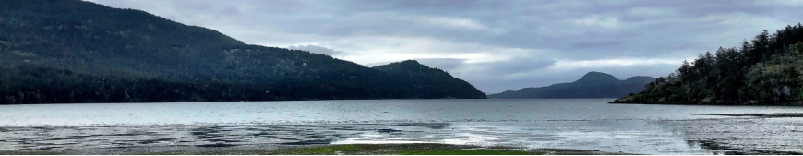
Summary of Changes by Ordinance Section

Slide 8
Ordinance Section 1 SJCC 18.20.140 “N” Definitions
Updates the definition of normal residential appurtenance.
Proposed changes include deletion of the term “patio” and replacing it with alternative language.
Clarifies the allowance for the sequence of construction on stairways to beaches on residential property.
Allows “other” normal residential appurtenances to be approved by the DCD director.
Ord. Page 5

Slide 9
Ordinance Section 1 SJCC 18.20.140 “N” Definitions
“Normal residential appurtenance, shoreline” means a structure or development that is necessarily connected to the use and enjoyment of a single-family residence and which is expressly defined in WAC 173-27-040 and in Chapter 18.50 SJCC, for purposes of exemption from shoreline substantial development permit requirements in accordance with WAC 173-27-040(g). Structures and activities considered normal residential appurtenances include accessory dwelling units or other detached residential structures approved by the director, garages, sheds, decks and patios attached to primary structures, private pedestrian pathways, stairways to access shorelines including those constructed prior to the construction of a residence on lots intended for single-family development, ramps, patios paved areas or areas assembled with solid materials such as an assembly of pavers attached to a home, fences, driveways, utilities, on-site sewage disposal systems, antennas, solar arrays, wind power generators serving a single structure, satellite dishes, boat houses landward of the primary residential structure served by marine railways that require a substantial development permit, official registered historic structures, and grading which does not exceed 250 cubic yards and which does not involve placement of fill in any wetland or waterward of the OHWM.
Ord. Page 5

Slide 10
Ordinance Sections 2 and 3 SJCC 18.20.190 “S” definitions SJCC 18.50.020 General
Section 2. Adds to the shoreline development definition:
It does not include dismantling or removing structures
if there is no other associated development or redevelopment.
Section 3. Allows the DCD director to make decisions on SSD permit applications for public pedestrian trails.
New Addition: Also allow for normal residential appurtenances and accessory structures that exceed the value thresholds.
(also add to Ord Section 11 18.80.110(G)(4).
Ord. Pages 8 & 14

Slide 11
Ordinance Section 4 SJCC 18.50.030 General applicability
Replaces subsection (2)(C) with the WAC for clarity:
“Those nonfederal lands lying within the exterior boundaries of federal lands and those federal lands leased to other persons, which fall within the definition of shorelands, shall be subject to the jurisdiction of Chapter 90.58 RCW. Areas and uses in those areas that are under exclusive federal jurisdiction as established through federal or state statutes are not subject to the jurisdiction of Chapter 90.58 RCW.”
Ord. Pages 16

Slide 12
Ordinance Section 4 SJCC 18.50.030 General applicability
New subsection E exempts developments not required to get shoreline permits or have local review (summarized):
Remedial actions;
Boatyard improvements to meet NPDES permit requirements;
WSDOT facility maintenance and safety improvements;
Projects consistent with environmental excellence program agreements; and
Projects authorized by the Energy Facility Site Evaluation Council process.
Ord. Pages 17

Slide 13
Section 5: SJCC 18.50.040 Exemptions from SSDs - General requirements
Updates the cost threshold for dock exemptions:
i. Twenty-two thousand five hundred dollars ($22,500) for docks that are constructed to replace existing docks, and are of equal or lesser square footage than the existing dock being replaced; or
ii. Eleven thousand two hundred ($11,200) dollars for all other docks constructed in fresh waters.
However, if subsequent construction occurs within five years of completion of the prior construction, and the combined fair market value of the subsequent and prior construction exceeds the amount specified above, the subsequent construction shall be considered a substantial development.
Ord. Page 19

Slide 14
Section 5: SJCC 18.50.040 Exemptions from SSDs - General requirements
Subsections 14 and 15:
14. Watershed restoration projects in accordance with WAC 173-27-040(2)(o) including a public or private project designed to improve fish or wildlife habitat or fish passage, that conforms to the provisions of RCW 77.55.181.
15. Habitat enhancement projects that conform to the provisions of RCW 77.55.290 and RCW 90.58.147 are consistent with local shoreline master programs. A public or private project that is designed to improve fish or wildlife habitat or fish passage in accordance with WAC 173-27-040(2)(p) and RCW 77.55.181, when all of the following apply (excerpt).
New Subsection 16 exempts retrofitting of existing structures to comply with the Americans with Disabilities Act.
Ord. Page 21

Slide 15
Section 6: SJCC 18.50.050 Exemptions from SSD requirements – Normal residential appurtenances
Subsection 1 is updated to use the current market value of $7,047.
Subsection (2)(i) amends permit requirements for existing temporary barge landing sites to:
not require a certificate of exemption if the proposed use is consistent with the historic transport of cargo at the site and frequency of the historic use.
Ord. Pages 22 and 23

Slide 16
Section 6: SJCC 18.50.050 Barge Landing Sites
After discussing with Ecology: Add a new ordinance section to amend the definition of temporary barge landing site to include the word development
18.20.020 “B” definitions.
“Barge landing site, temporary” means a location where a limited number of landings are allowed that will not result in permanent disturbance of the earth, development or permanent adverse impacts on shoreline ecological functions.
Ord. Pages 22 and 23

Slide 17
Section 7: Amends SJCC 18.50.450 Forest Practices
Amends Subsection 2 to clarify that:
Cutting of timber solely incidental to the preparation of land for other uses authorized by this chapter is not considered a development under the SMA, and
Does not require a shoreline exemption or substantial development permit and is allowed.
Ord. Page 24

Slide 18
Section 8: SJCC 18.50.540(D) Residential development
Will be updated to simplify after discussion with Ecology.
Subsection 1: Change patio to paved areas or areas assembled with solid materials such as an assembly of pavers attached to a home consistent with the proposed definition. This change will not be needed any more.
Subsection 3: Normal residential appurtenances not identified in the definition or in subsection 4 below are allowed with a conditional use permit. This requirement for a conditional use permit will be struck out. It is not necessary.
Ord. Pages 27 - 39

Slide 19
Section 8: SJCC 18.50.540(D) Residential development
New Subsections 4, 5, 6 & 7 codify Policy PP 2019 standards for certain non-water-dependent residential appurtenances:
Seaward of home outside aesthetic setback & critical area buffers.
Lot width requirement is not applicable if <30” tall.
Subsection 6: Standards for at-grade paving & decks <30” tall.
Do not need to meet the shoreline aesthetic buffer. Must meet the no net loss standard in SJCC 18.50.120.
Above-grade paving and decks attached to the house >30” tall -subject to the same regulations as the home.
Ord. Pages 27 - 39

Slide 20
Section 8: SJCC 18.50.540 Residential development
Plug in hot tubs can be on paving or decks attached to a home.
Subsection 7: Certain temporary uses do not require a shoreline exemption or permit if there is no trees or vegetation removal within critical area buffers or the shoreline aesthetic setback: temporary fire rings/bowls; dog houses (3’ x 3’); & moveable furniture.
Subsection 8 codifies fencing policy including deer fencing that must:
Be landward of the residence and meet aesthetic setback, and
Meet critical area buffers to meet the no net loss.
Ord. Pages 27 - 39

Slide 21
Section 8: SJCC 18.50.540 Residential development New proposal: simplified
D. Regulations – Normal Residential Appurtenances and Accessory Structures.
1. Normal residential appurtenances and accessory structures are not allowed in critical area buffers SJCC 18.50.120 except for:
a. Private pedestrian pathways, stairways, ramps, and boathouses served by marine railways, and
b. Temporary fencing for shoreline habitat and natural systems enhancement projects pursuant to SJCC 18.50.590.
The critical area buffers required by SJCC 18.50.120, 18.50.130 and Chapter 18.35 SJCC must be met to achieve the no net loss standard in SJCC 18.50.120. A no net loss report may not be used to meet the critical area requirements because avoidance, the first step in the mitigation sequence analysis required by SJCC 18.50.120(B) and 18.50.140, cannot be met.
Ord. Pages 27 - 39

Slide 22
Section 8: SJCC 18.50.540 Residential development
D. Regulations – Normal Residential Appurtenances and Accessory Structures.
2. Normal residential appurtenances and accessory structures are not allowed in the shoreline aesthetic buffer except for:
a. Private pedestrian pathways, stairways, ramps, and boathouses served by marine railways and normal residential appurtenances,
b. Normal residential appurtenance structures and accessory structures less than thirty inches in height, and
c. Temporary fencing for shoreline habitat and natural systems enhancement projects pursuant to SJCC 18.50.590.
3. Accessory dwelling units must comply with SJCC 18.40.240.
4. The lot width requirement in SJCC 18.50.540(A)(2) does not apply to normal residential appurtenances and accessory structures less than thirty inches in height.
Ord. Pages 27 - 39

Slide 23
Section 9: SJCC18.50.550 Transportation facilities and parking
Clarifies permit requirements for existing nonconforming temporary barge landings:
1. New Ttemporary barge landing sites require a certificate of exemption but are exempt from a shoreline substantial development permit. These sites shall not exceed 12 landings in any 24-month period and must be operated in a manner that will result in no net loss of shoreline ecological functions. Existing nonconforming temporary barge landing sites do not require a certificate of exemption if the proposed use is consistent with the historic transport of cargo at the site and frequency of the historic use.
Ord. Page 33

Slide 24
Section 10: SJCC 18.50.600 Shoreline developments, uses, structures & activities by designation
Makes institutional uses the same as those in the commercial category by adding water-related and water-enjoyment uses to the category.
A new footnote number 7 is added to public pedestrian trails to provide notice that the DCD director is the local decision-maker for public pedestrian trails permit applications.
Ord. Pages 39 & 42

Slide 25
Section 11: SJCC18.80.110(G) and (H) Shoreline pre-application meetings, exemption procedures, and vesting
Updates “Date of filing” to “date of receipt” for shoreline permits sent to Ecology.
Adds Attorney General to the notification list.
New subsection (H)(3) authorizes the DCD director to make decisions on applications for public pedestrian trails. Also allow for normal residential appurtenances and accessory structures that exceed the value thresholds.
A code reference is corrected in (I)(3).
Ord. Pages 46 - 48

Slide 26
Section 12: SJCC 15.12.030 Definitions.
Updates name to Federal Insurance and Mitigation Administration in other definitions.
Includes the legislature’s option for defining "floodway" as set in the SMA.
“Floodway” means the channel of a river or other watercourse and the adjacent land areas that must be reserved in order to discharge the base flood without cumulatively increasing the water surface elevation more than one foot. The floodway is established by the Federal Insurance and Mitigation Administration on its Flood Insurance Rate Maps (FIRMs). It does not include lands that can be reasonably expected to be protected from flood waters by flood control devices maintained by or maintained under license from the federal government, the state or a political subdivision of the state.
Ord. Page 57

Slide 27
Sections 13 and 14
Effective date and codification instructions.

Slide 28
Project website:
https://www.sanjuanco.com/1643/Shoreline-Master-Program-Periodic- Update
Staff reports, resources, notices, and public participation plan including a tentative schedule are on the project webpage.

Slide 29
How to Obtain Notices and Comment
Subscribe for project newsflashes and notices at: https://www.sanjuanco.com/list.aspx.
Select SMP Update under “news flashes.”
Project email: SMPComments@sanjuanco.com.

Slide 30
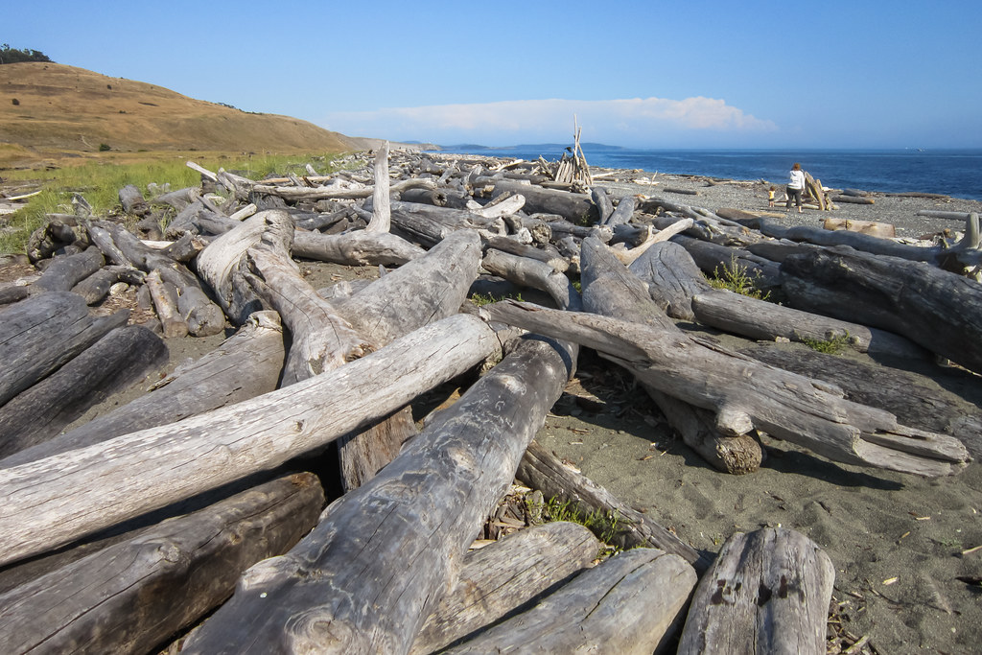
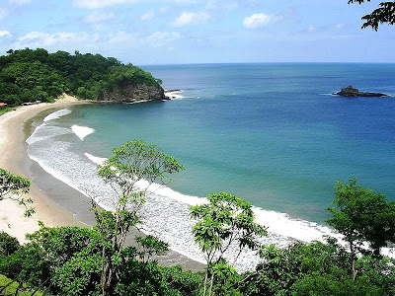
Questions?

