Slide 1
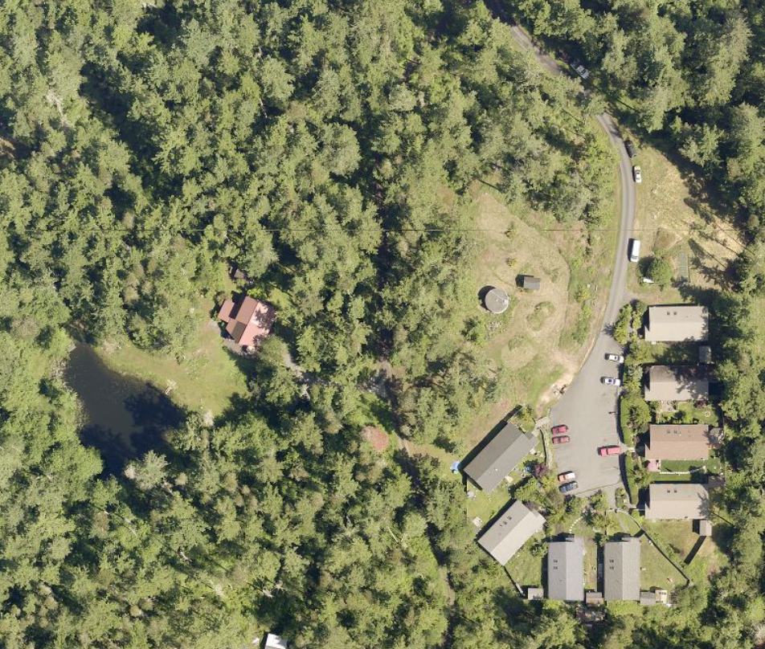
Rural Residential Cluster Development
Follow-up Discussion and
Q&A with Affordable Housing Non-Profits
Planning Commission, October 16, 2020
Sophia Cassam, DCD, Planner I

Slide 2
Today
Staff report briefing
Q&A with Affordable Housing Non-profits
Discuss code change options

Slide 3
Cluster Development Issues
Discussed at September 18, 2020 PC meeting
Limits to the number of units in a cluster development
Limits to the size of cluster development structures
Cluster development ownership requirements
Assurance of affordability requirements

Slide 4
Staff Follow-up on PC questions
# of cluster developments in the County
Are vacation rentals allowed in cluster developments?
Ensuring requirements are met over time
How is building square footage counted?
How do cluster development standards and design standards protect rural character?

Slide 5
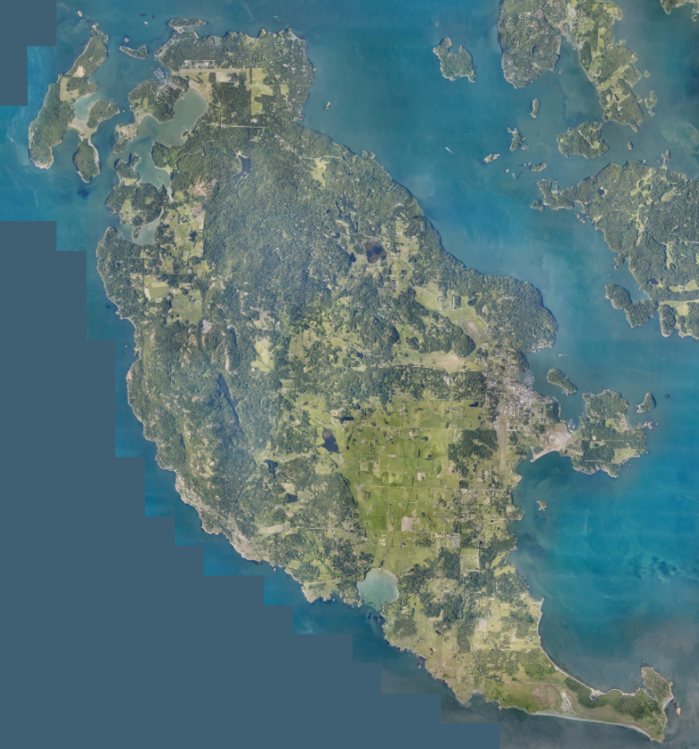
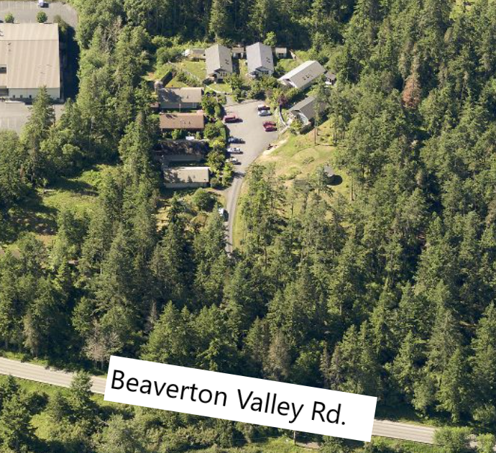
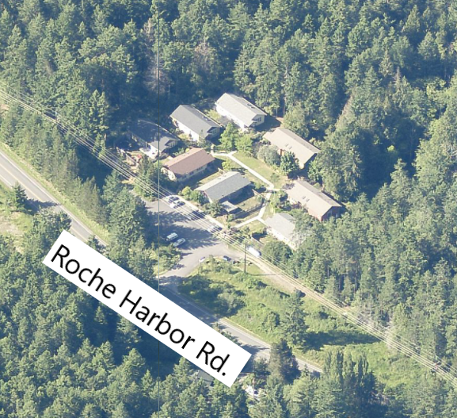
Cluster Developments in SJC
Leeward Cove (completed 2006)
Rocky Bay (completed 2007)
Rocky Bay
Leeward Cove
Source: San Juan County GIS

Slide 6
Use as Vacation Rentals
Regulations do not restrict cluster units from having vacation rental permits
Currently, no affordable housing units have vacation rental permits
Units are unlikely to be used as vacation rentals because the unit must be the owner’s primary residence
Some affordable housing restrictive use easements have had clauses prohibiting short-term rentals
Planning Commission could recommend prohibiting vacation rentals in cluster developments

Slide 7
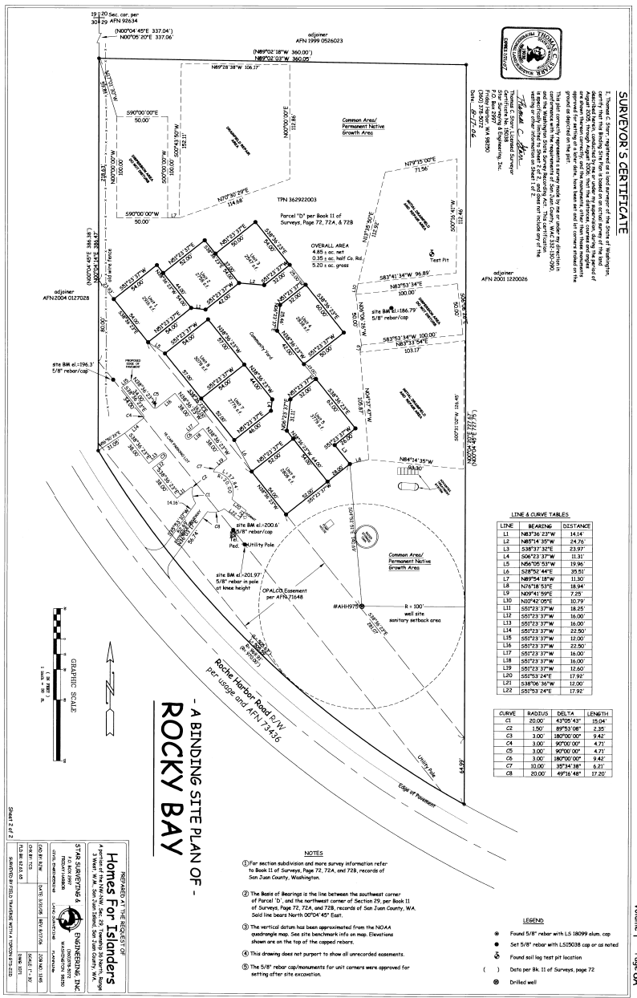
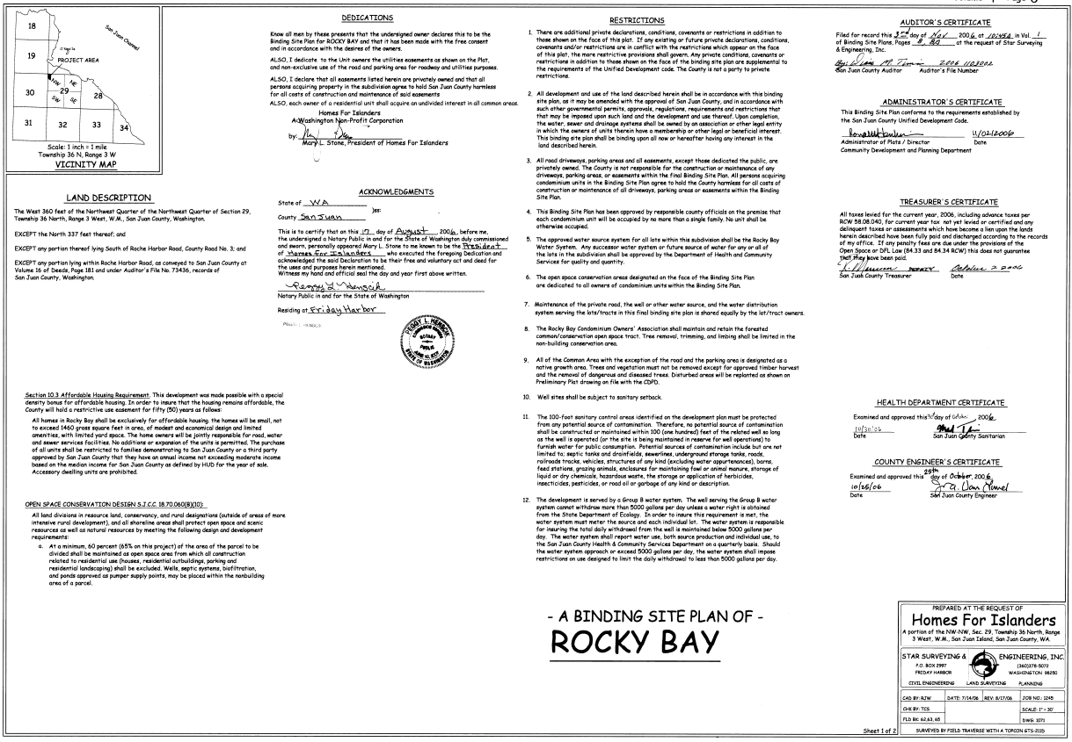
How does SJC ensure requirements are met over time?
See full size in Attachment A in Staff Report

Slide 8
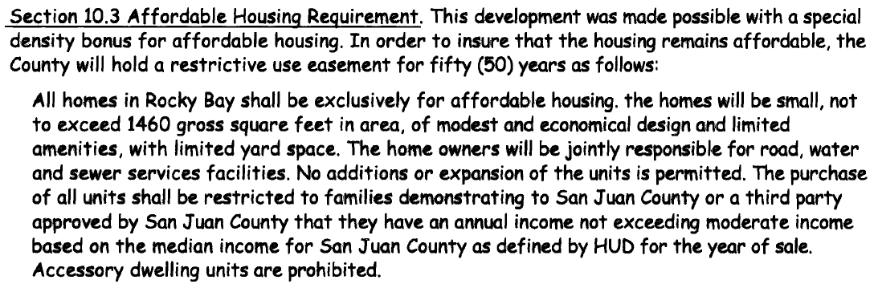
How does SJC ensure requirements are met over time?

Slide 9
How is building square footage counted?
SJCC 18.60.230(C)(6) states: “The total enclosed floor area of structures including dwelling units and accessory structures shall not exceed 1,500 square feet per dwelling unit.”
How should this apply?

Slide 10
How is building square footage counted?
Option A: Dwelling units (including associated accessory structures) shall not exceed 1,500 square feet each.
Option B: The average square footage per dwelling (including associated accessory structures) shall not exceed 1,500 square feet across the development.
All units: 1,500 sq. ft.
Units of various sizes.
Average 1,500 sq. ft.

Slide 11
How do cluster development standards protect rural character?
Design Standards (SJCC 18.60.230(G)(1)&(2))
Visual shielding from surrounding uses and roads
Must be small-scale
Separation requirements
Architectural variation for multi-unit dwellings
Other development standards
No urban-level services
Max. density: 2 units/acre.
Max. # units/cluster: 8

Slide 12
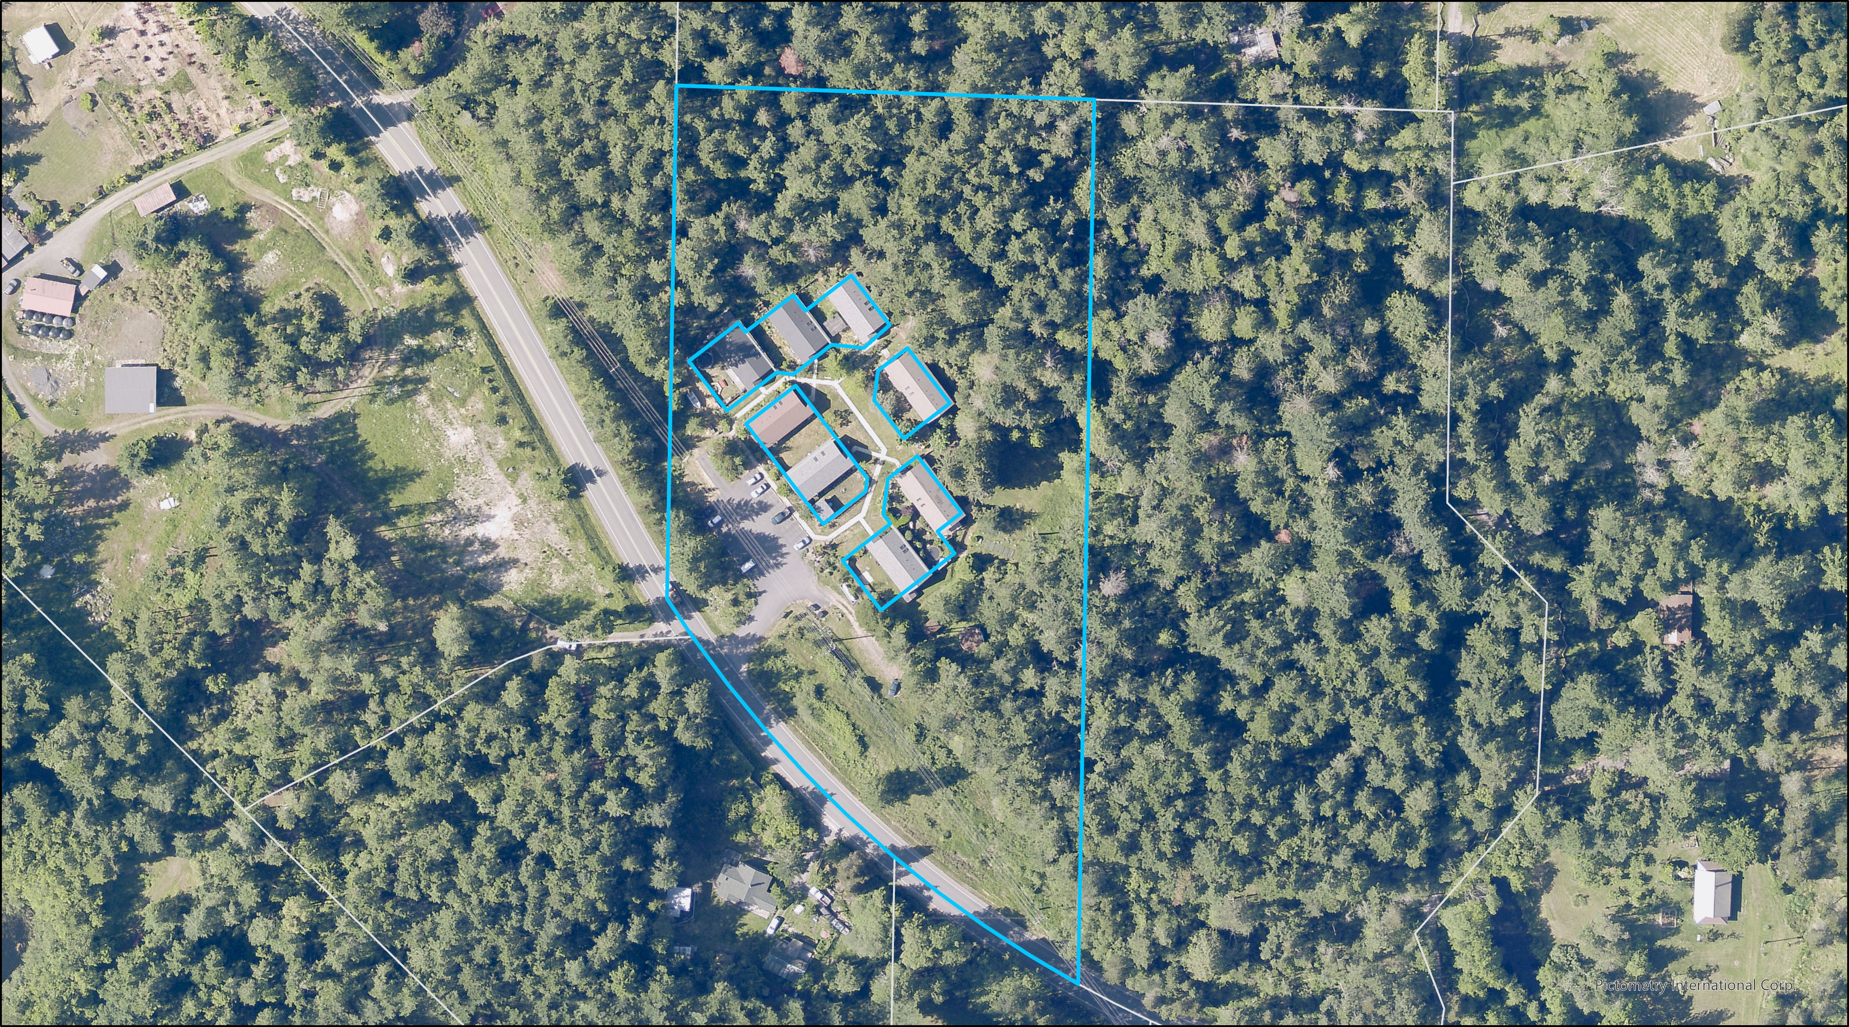

Slide 13
Today’s Guests
OPAL
Community Land Trust:
Lisa Byers
Lopez
Community Land Trust:
Sandy Bishop
Homes for Islanders:
Justin Roche

Slide 14
Questions
Why should the number of units per cluster be increased from 8 to 12?
Why should the limit on square footage per dwelling be increased?
Should the code be changed to allow anyone to build cluster developments?
Why should the requirement for restrictive use easements be removed?
What other challenges do you face when considering cluster developments?
What are the benefits of developing in rural areas as opposed to in UGAs?

Slide 15
Code change options discussion
Limits to the number of units in a cluster development
Limits to the size of cluster development structures
Cluster development ownership requirements
Assurance of affordability requirements

Slide 16
Issue One: Limits to the number of units allowed Option A: Update SJCC 18.60.230(C)(5)(b) to allow a maximum of twelve dwelling units in rural residential clusters Option B: No change

Slide 17
A: increase the maximum allowed sq. ft. for cluster dwellings to 1,750 sq. ft., not including accessory structures. [Homes for Islanders request] B: increase the maximum allowed sq. ft. for cluster dwellings to 2,000 sq. ft., including accessory structures. C: No Change
Issue Two: Limits to the size of structures

Slide 18
How is building square footage counted?
Option A: Dwelling units (including associated accessory structures) shall not exceed 1,500 square feet each.
Option B: The average square footage per dwelling (including associated accessory structures) shall not exceed 1,500 square feet across the development.
All units: 1,500 sq. ft.
Units of various sizes.
Average 1,500 sq. ft.

Slide 19
A: Allow any developer to build cluster developments according to the standards in SJCC 18.60.230 B: No change
Issue Three: Ownership requirements

Slide 20
A: Amend the cluster development code to require developers to demonstrate assurance of affordability by some but not all the options listed in the affordable housing code. B: No Change
Issue Four: Assurance of Affordability

Slide 21
D. Long-Term Affordability. In order to qualify as affordable housing, housing must provide assurance of affordability to applicable income groups for at least 50 years for ownership housing and 20 years for rental housing by one or more of the following methods: 1. Ownership of land or land and structures by a public agency or nonprofit housing provider; 2. Granting of a restrictive use easement in a form specified by the County for the portions of the site encompassing the affordable units to San Juan County for the purpose of affordable housing development; 3. In the case of rental housing only, the units are subject to a contract with a housing provider which assures their affordability for a minimum of 20 years; or 4. Housing which because of its size, location, amenities, restrictions on development or use, or other characteristics, has been specifically determined by resolution of the board of County commissioners to be affordable. E. Permanently Affordable Housing. In order to qualify as permanently affordable housing, housing must provide assurance of affordability to applicable income groups for at least 99 years by one or more of the following methods: 1. Ownership of land or land and structures by a public agency or nonprofit housing provider with assurance of affordability for at least 99 years; 2. Granting of a restrictive use easement in a form specified by the County for the portions of the site encompassing the affordable units to San Juan County for the purpose of affordable housing development; 3. Housing which because of its size, location, amenities, restrictions on development or use, or other characteristics, has been specifically determined by resolution of the board of County commissioners to be permanently affordable.
SJCC 18.60.260

